Slide 1

Implementing altmetrics at The University of Manchester
Tue 14th July, UKSG webinar
Scott Taylor, The University of Manchester Library

Slide 2
Why were we interested in altmetrics?

Slide 3
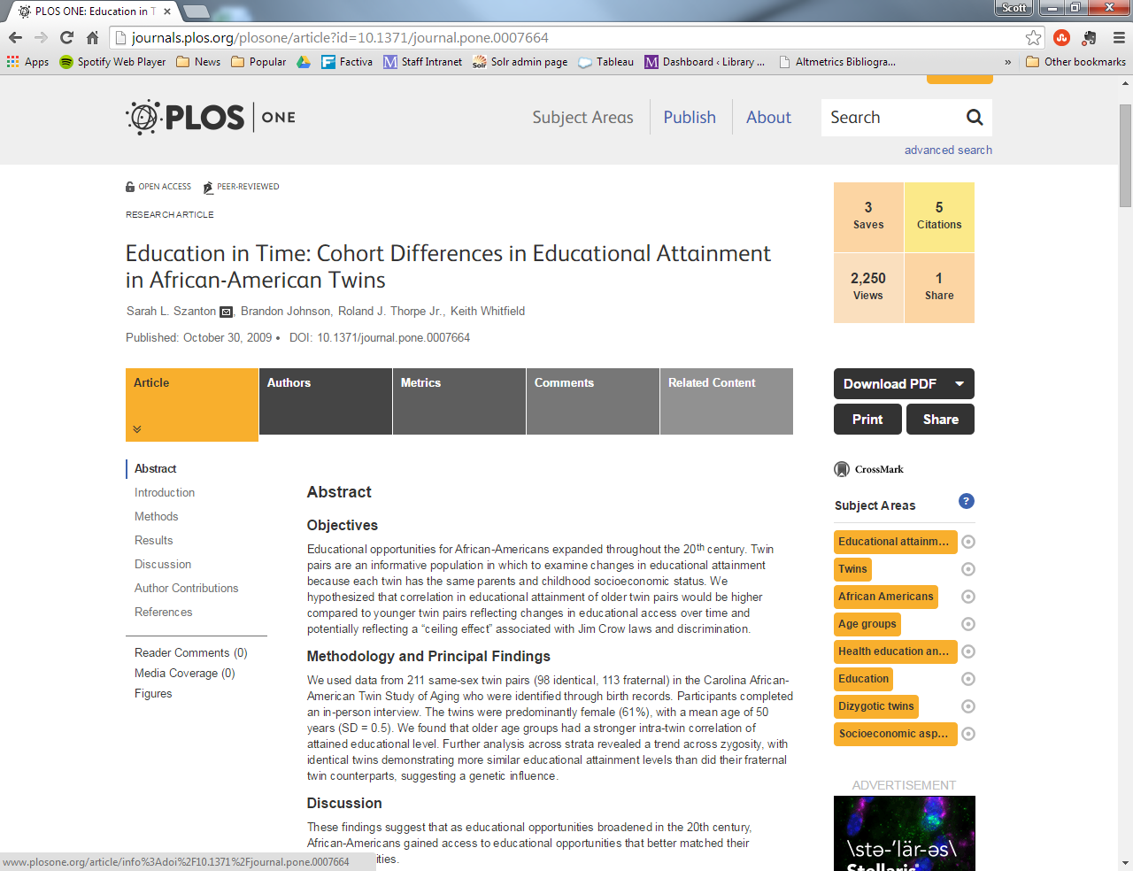

Slide 5


Slide 7
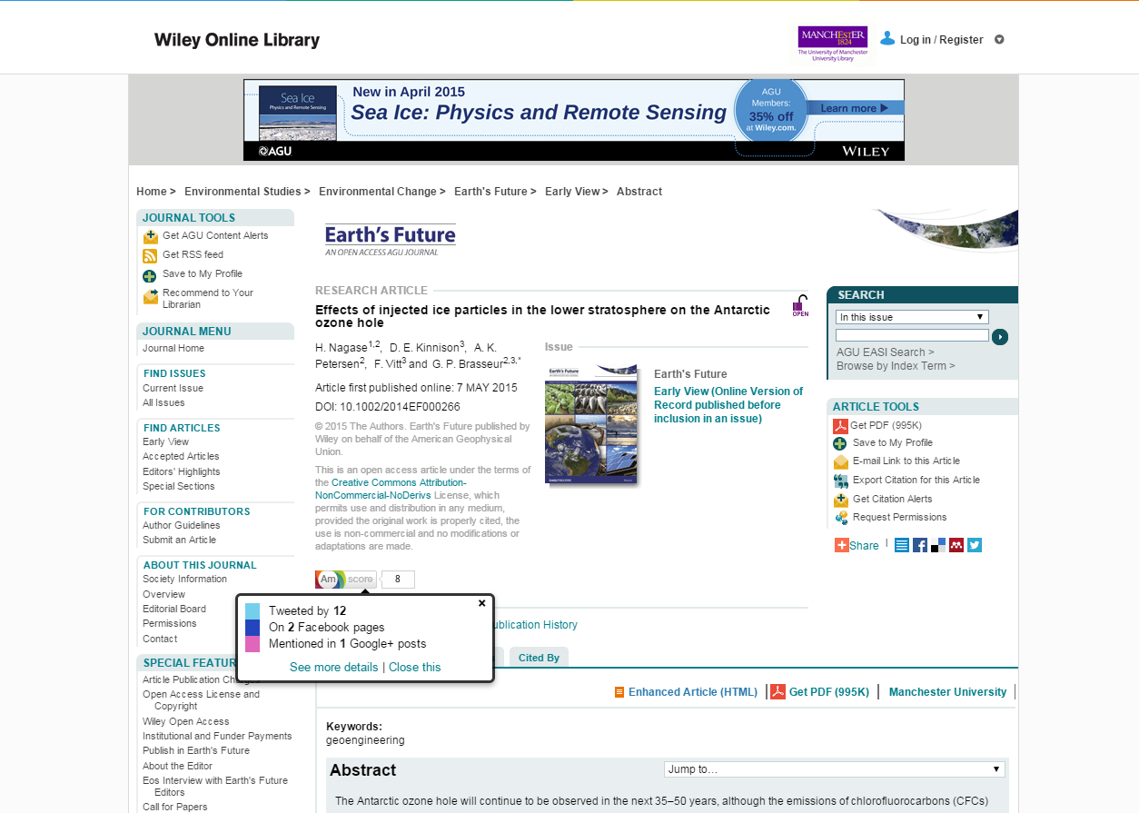

Slide 9
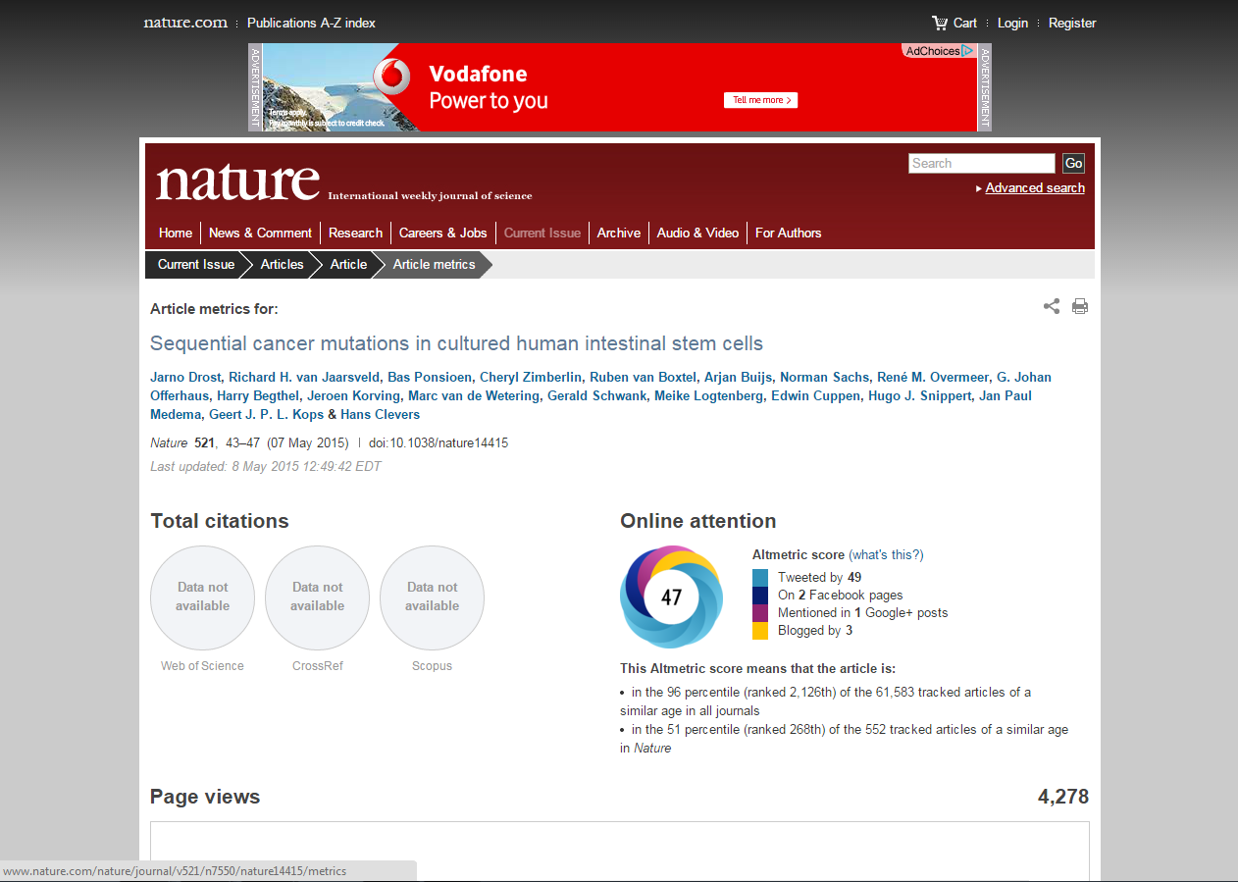

Slide 11


Slide 12
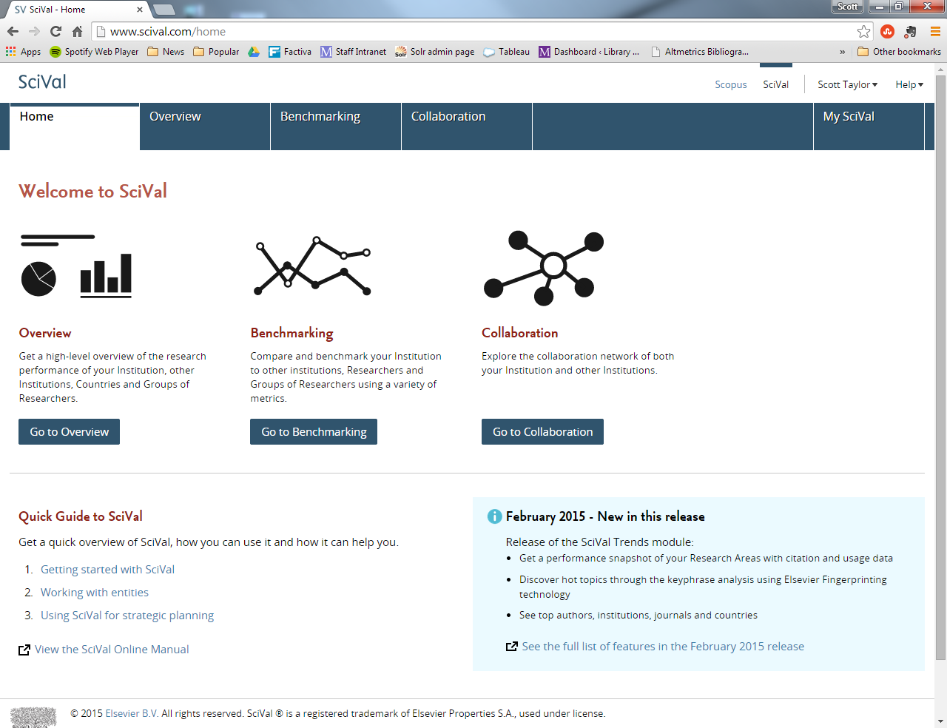

Slide 13
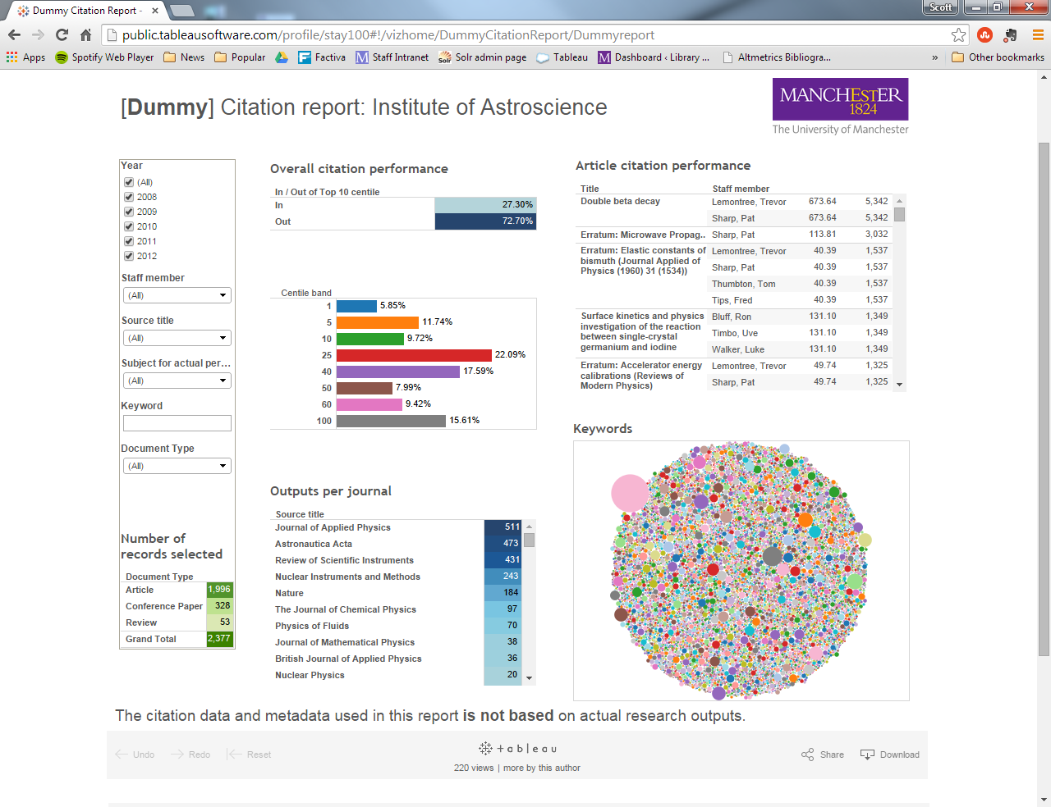

Slide 14
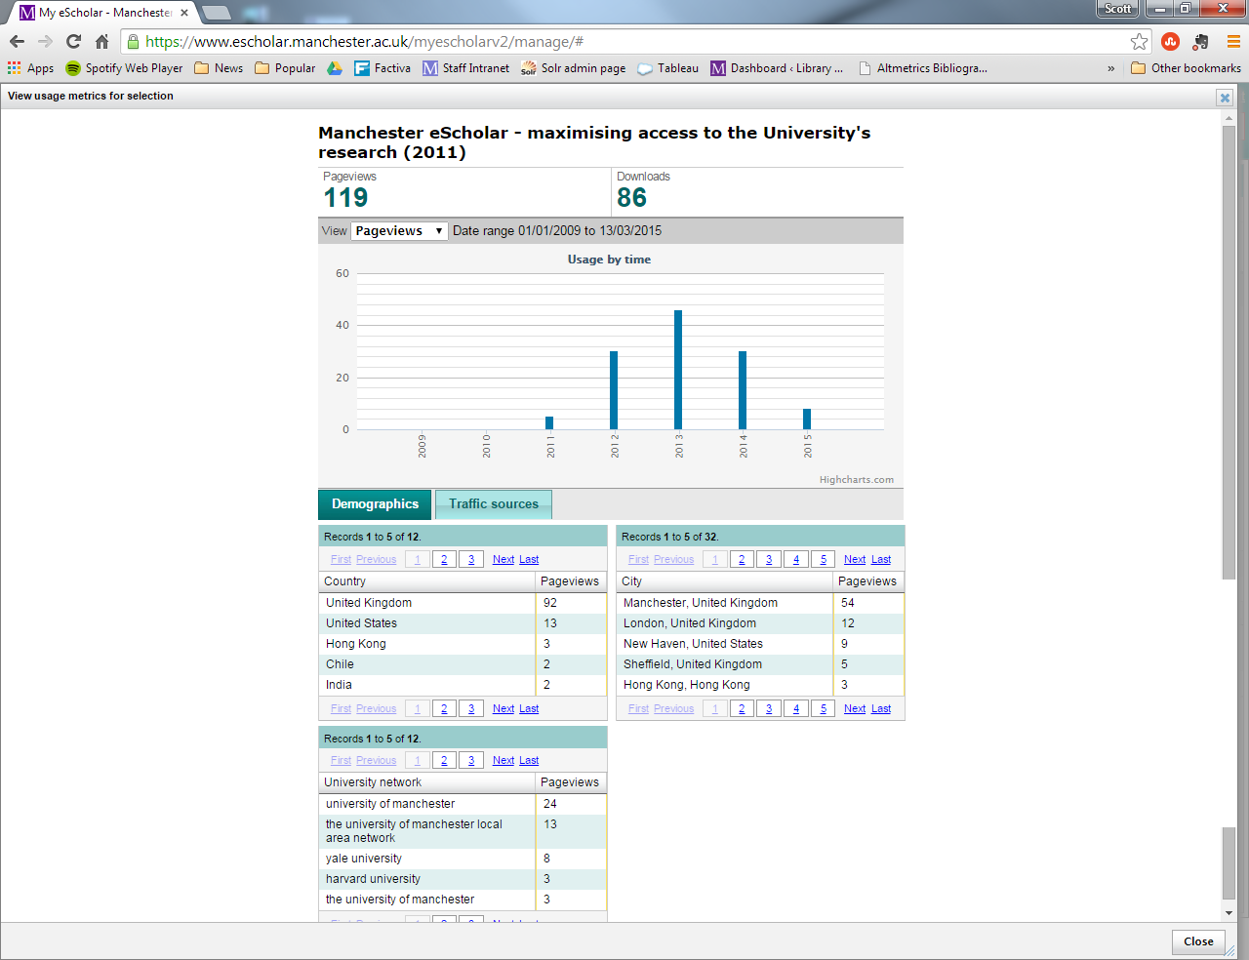

Slide 15
Which tools/services are the best fit for us?

Slide 16









Slide 17

By Bill Ebbesen [CC BY 3.0 (http://creativecommons.org/licenses/by/3.0)], via Wikimedia Commons

Slide 18
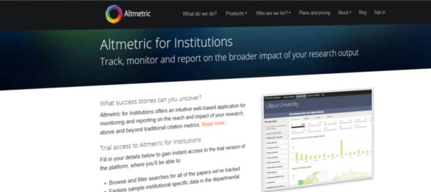

Slide 19
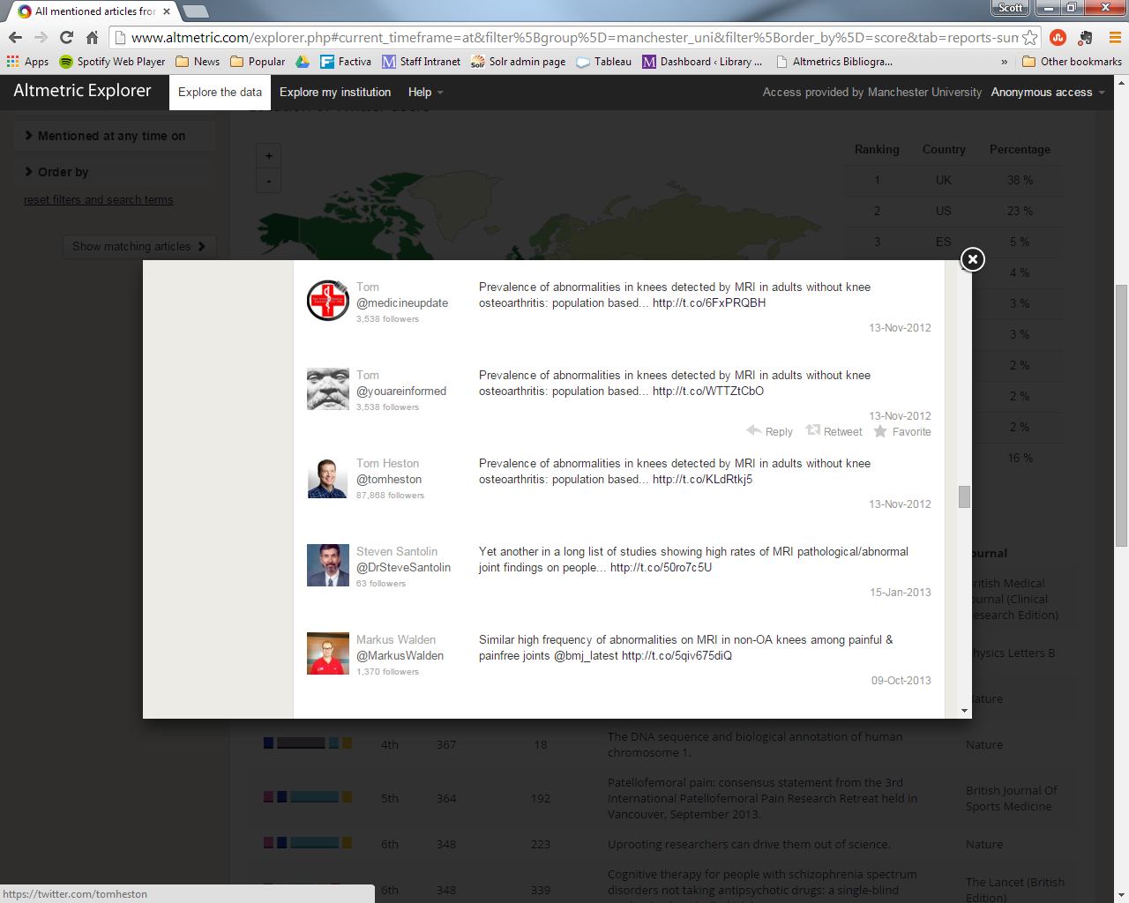

Slide 21
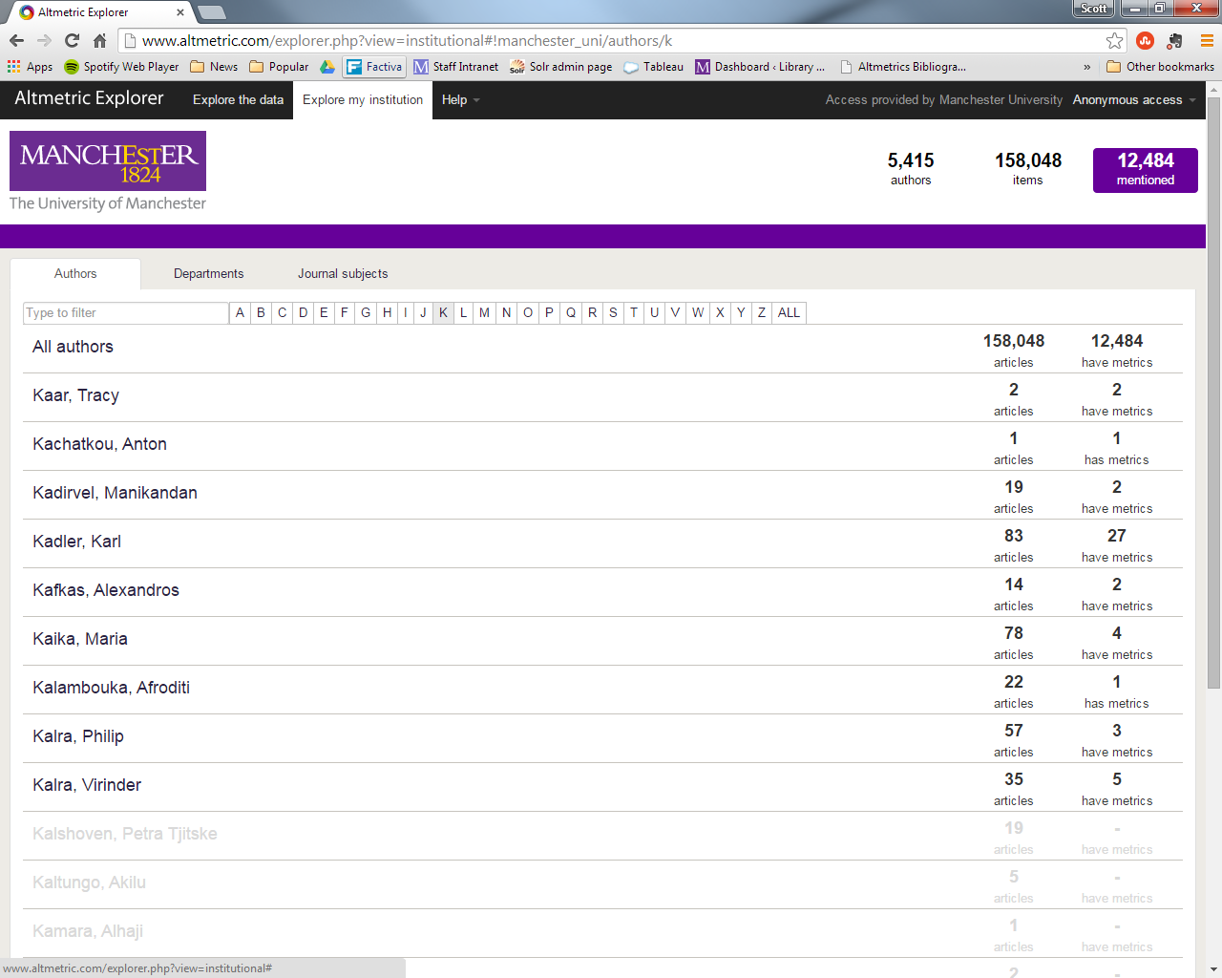

Slide 22
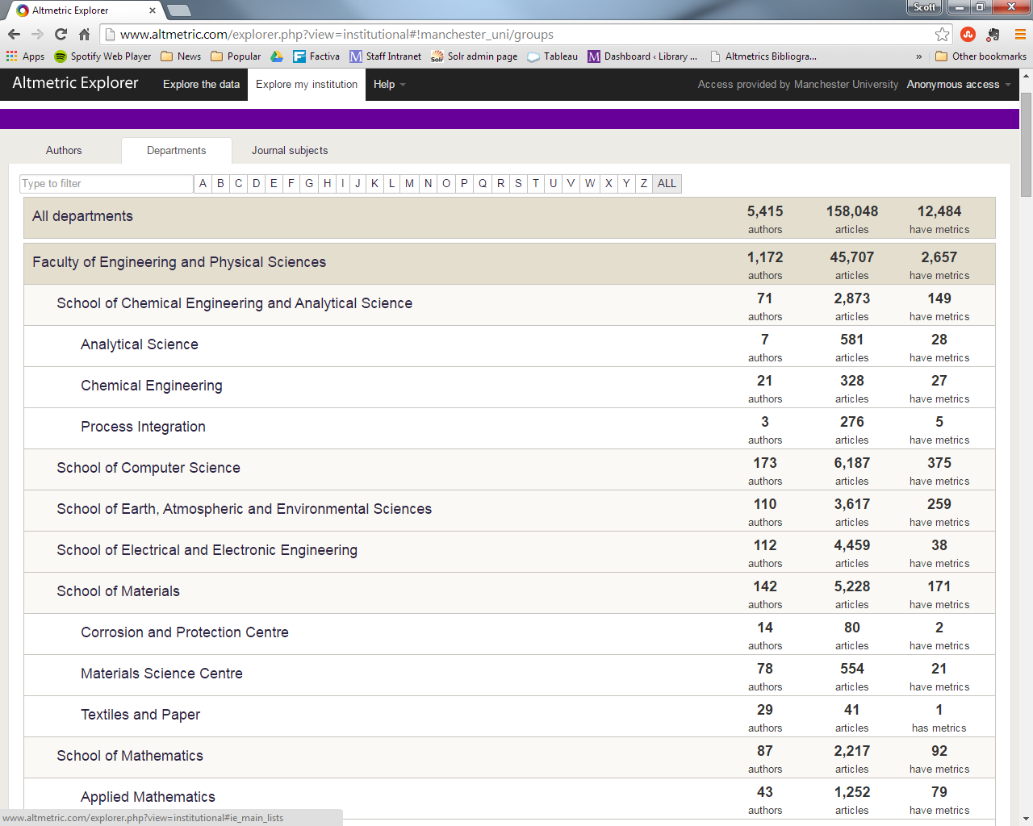

Slide 23
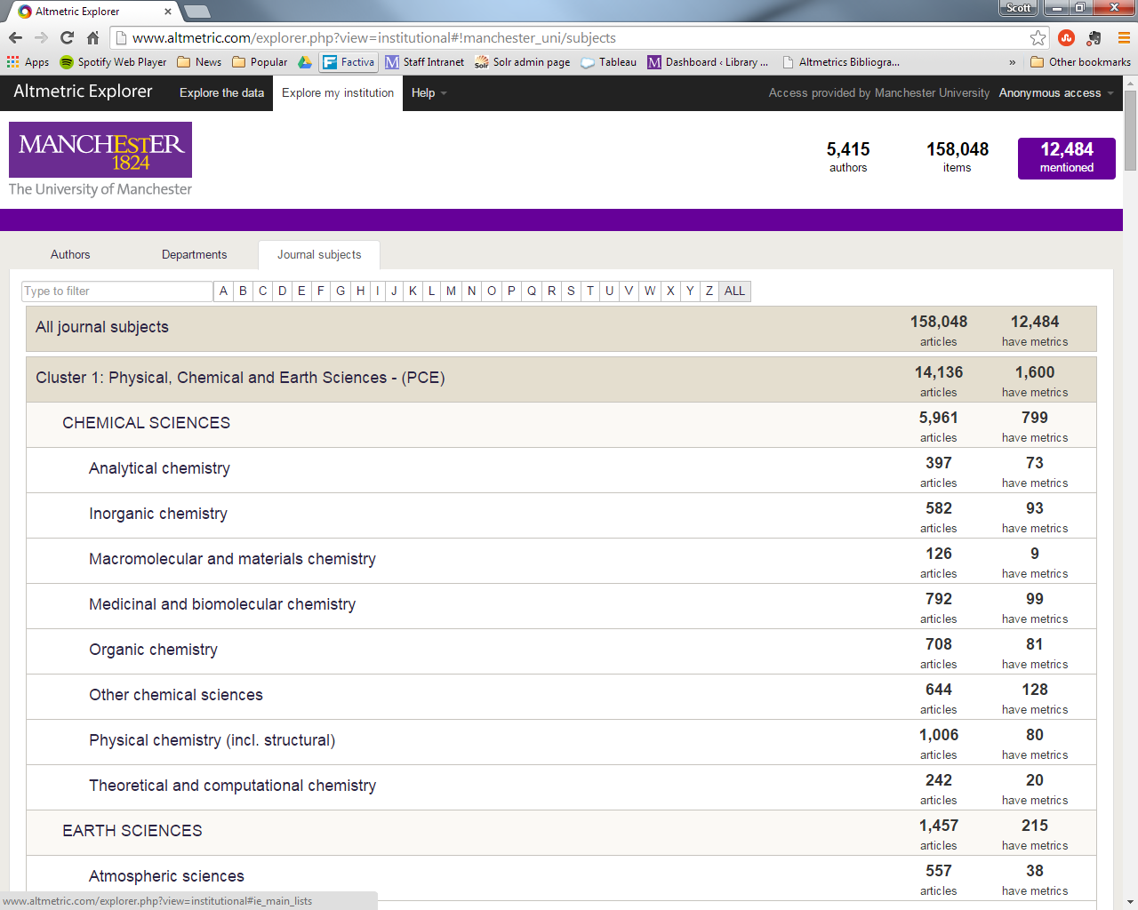

Slide 24
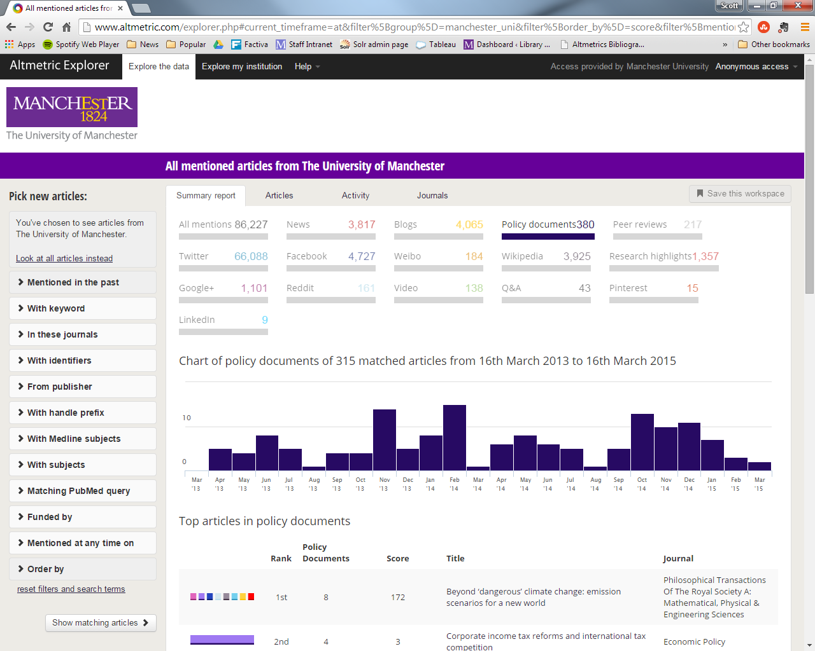

Slide 25
How we trialled AFI

Slide 26
Set-up
Library provides Altmetric with data
Altmetric configure UoM app
Create user groups
RS Team identify tier 1 group
AE Team identify tier 2 group
Test phase
User groups test application
Feedback
Tier 1 group attend Focus Group
Tier 2 group provide written feedback

Slide 27

Set-up
Library provides Altmetric with data
Altmetric configure UoM app
Create user groups
RS Team identify tier 1 group
AE Team identify tier 2 group
Test phase
User groups test application
Feedback
Tier 1 group attend Focus Group
Tier 2 group provide written feedback
Institutional Repositories

Slide 28
Set-up
Library provides Altmetric with data
Altmetric configure UoM app
Create user groups
RS Team identify tier 1 group
AE Team identify tier 2 group
Test phase
User groups test application
Feedback
Tier 1 group attend Focus Group
Tier 2 group provide written feedback
Tier 1 user group
Tier 2 user group

Slide 29

Set-up
Library provides Altmetric with data
Altmetric configure UoM app
Create user groups
RS Team identify tier 1 group
AE Team identify tier 2 group
Test phase
User groups test application
Feedback
Tier 1 group attend Focus Group
Tier 2 group provide written feedback
By Tweedewereldoolog-wiki (Own work) [Public domain], via Wikimedia Commons

Slide 30

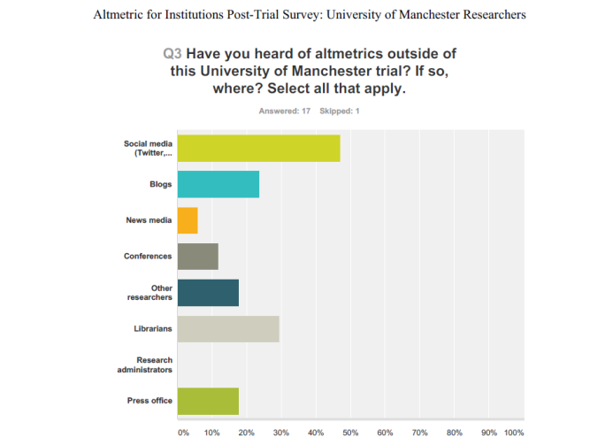
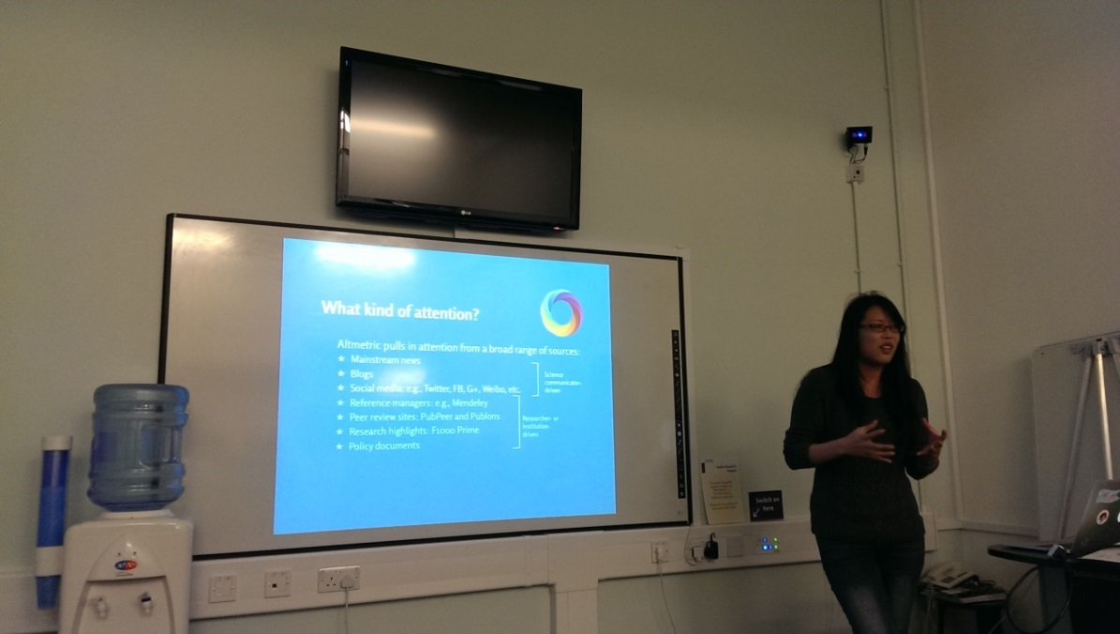
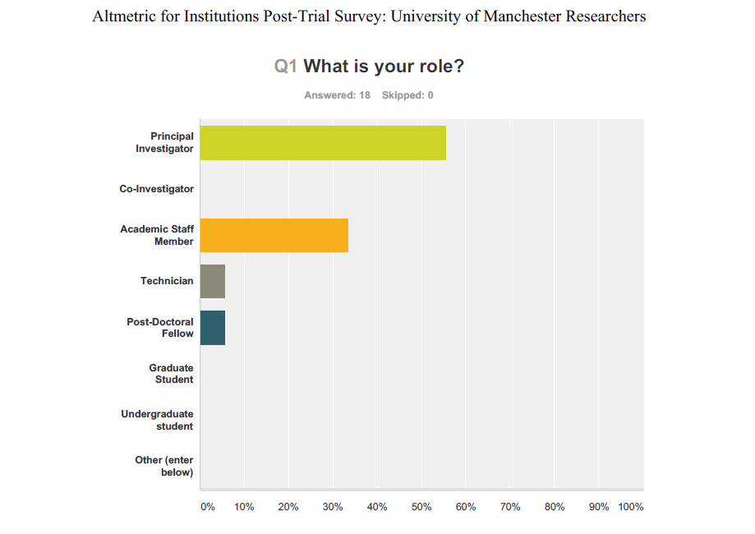
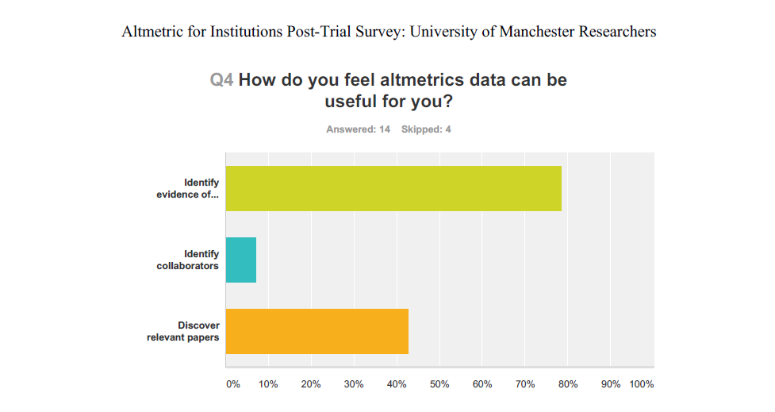
Set-up
Library provides Altmetric with data
Altmetric configure UoM app
Create user groups
RS Team identify tier 1 group
AE Team identify tier 2 group
Test phase
User groups test application
Feedback
Tier 1 group attend Focus Group
Tier 2 group provide written feedback

Slide 31
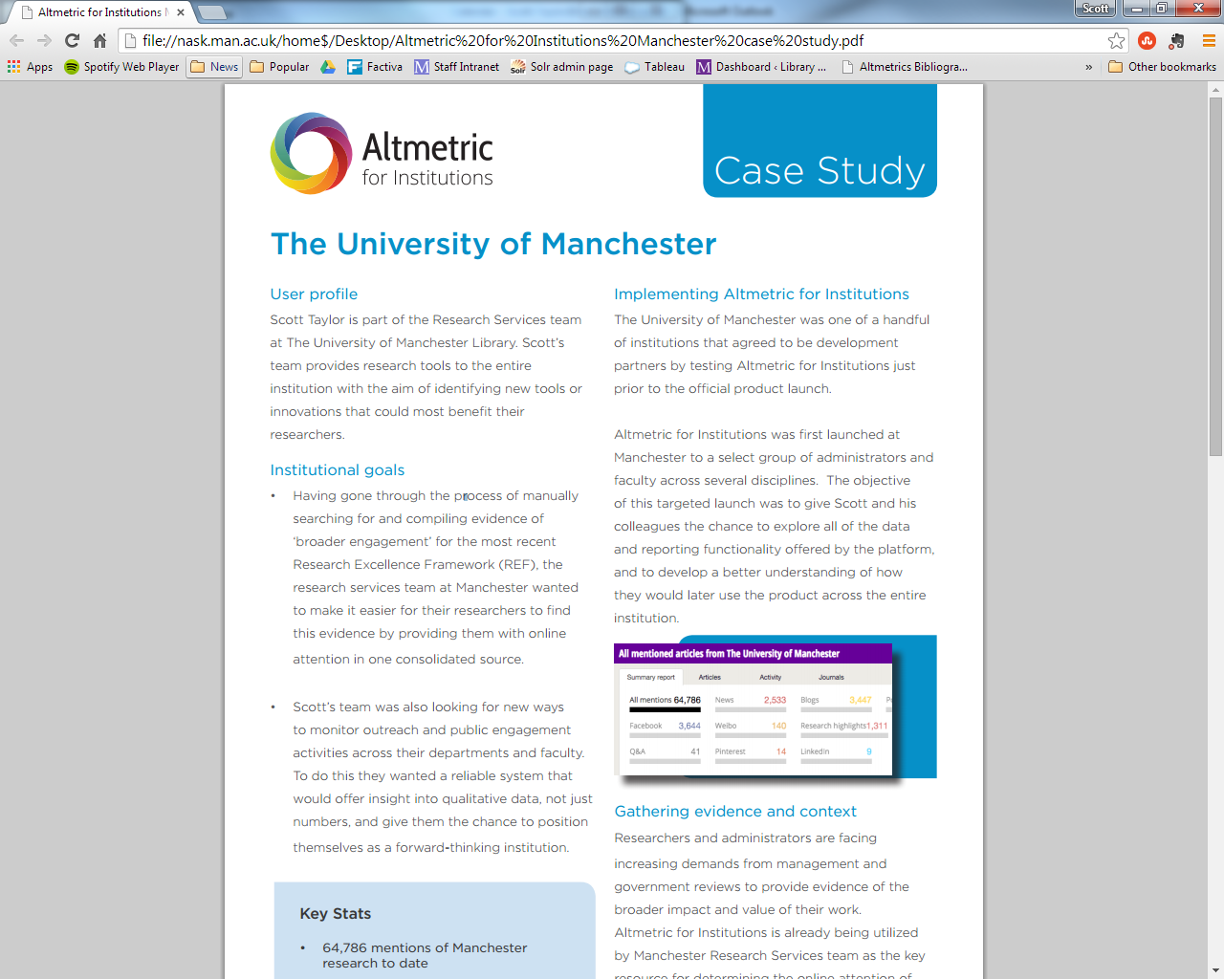

Slide 32
Roll out of altmetrics

Slide 33
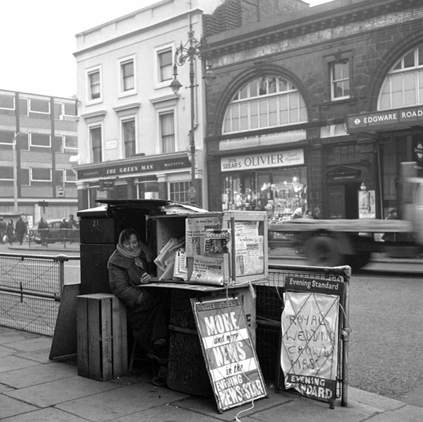
By Chris Brown (Edgware Road) [CC BY-SA 2.0 (http://creativecommons.org/licenses/by-sa/2.0)], via Wikimedia Commons

Slide 34


Slide 35






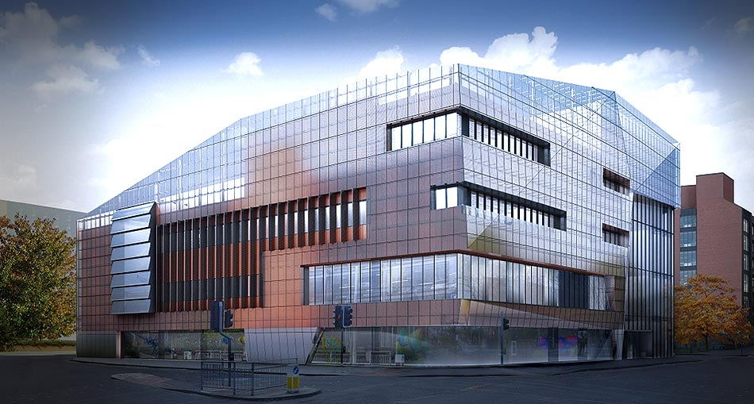

Slide 36
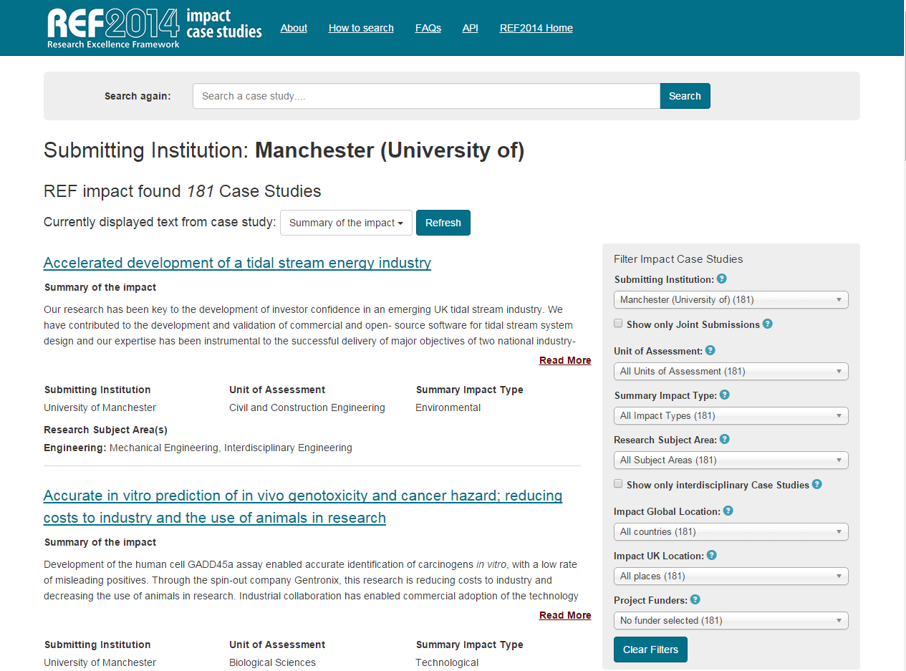

Slide 37
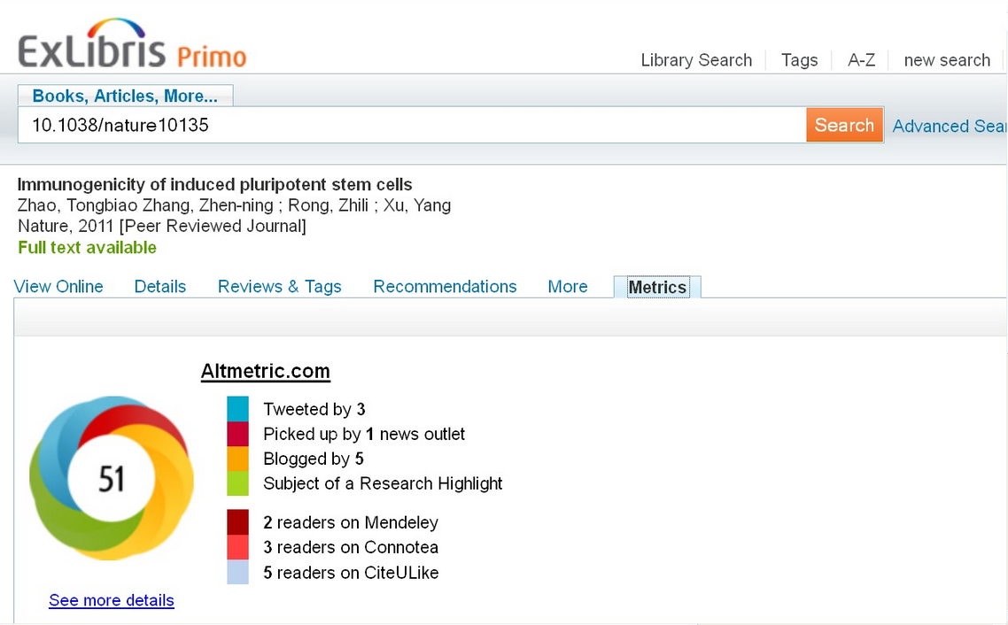

Slide 38
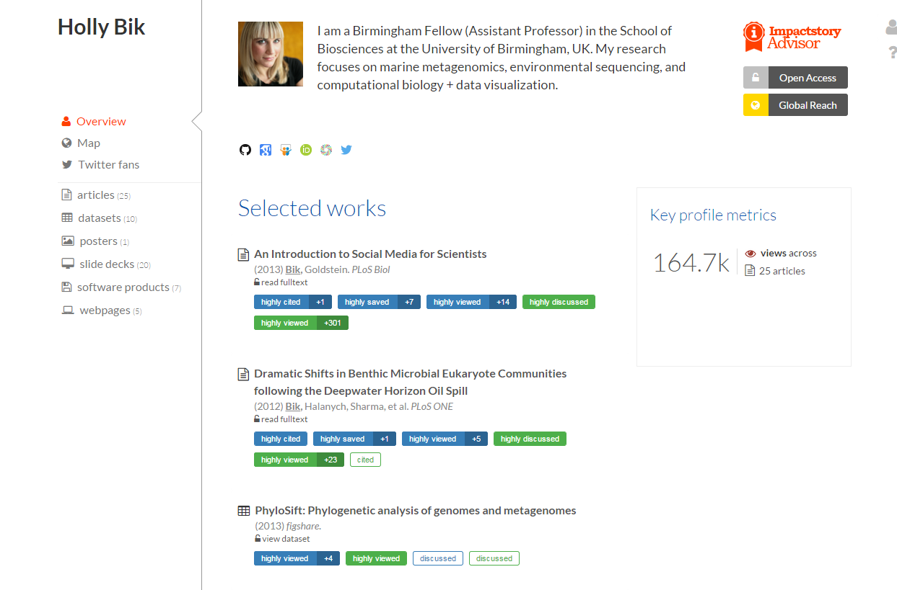

Slide 39
Contacts
Scott Taylor: scott.taylor@manchester.ac.uk
Timon Oefelein: timon.oefelein@springer.com
Martijn Roelandse: martijn.roelandse@springer.com
Altmetric.com: support@altmetric.com

