Slide 1
The next step: how FE and HE libraries can work together to improve the transition of students from one to the other
Mike Jones
Information Librarian
Solent Library

Slide 2
Introduction
2005
2005: Library Assistant at Barton Peveril Sixth Form College
2010
2013: Senior Library Assistant at Barton Peveril Sixth Form College
2015
2015: Assistant Library Manager at Barton Peveril Sixth Form College
2015: MA Information & Library Management from Northumbria University
2018: Assistant Librarian at University of Winchester
2020
2022: Information Librarian at Southampton Solent University
2025

Slide 3
Survey of local FE & HE libraries

Slide 4


Size of libraries
Further Education
60% have 1 floor
40% have 2 floors
Higher Education
60% have 5 or more floors
40% have 3 floors
Food policy
Further Education
NO FOOD
10% neither food or drink allowed
50% bottled drinks only
40% any drinks
Higher Education
ALL ALLOW FOOD & ANY DRINKS
60% hot food only in certain areas
20% cold food only
20% food & drink in certain areas only

Slide 5


Noise expectations
Further Education
50% quiet
40% group
10% silent
Higher Education
40% group
20% quiet
40% no dominant expectation
Noise options
Space type | FE | HE
Silent study | 70% | 100%
Quiet study | 70% | 80%
Group study | 70% | 100%
Social study | 20% | 80%

Slide 6
Facilities & services
Service/Facility | FE | HE
Bookable group study rooms/pods | 70% | 80%
Bookable individual silent study rooms/pods | 10% | 60%
Laptop borrowing | 80% | 80%
Late night opening as standard | 20% | 30%
24/7 opening during key periods | 0% | 40%
24/7 opening all year round | 0% | 20%
Bookable 1:1 or small group appointments with a Librarian | 70% | 100%

Slide 7


Percentage of students who get direct information skills training
Further Education
Range of 10-70%
Average of 40%
Higher Education
Range of 70-100%
Average of 80%
Referencing styles
Further Education
Harvard (standard), MHRA, Vancouver, APA and Chicago
Average of 1.6 styles per institution
Higher Education
Harvard (standard), Harvard (institutional), OSCOLA, APA, Vancouver, Chicago, MHRA, IEEE and MLA
Average of 4.2 styles per institution

Slide 8
Transition from FE to HE

Slide 9

Transition from FE to HE
“change navigated by students in their movement within and through formal education”
(Gale and Parker 2014)
“Transition is a complex phenomena that might be more helpfully described as a spectrum of experience that play out differently for different students joining different institutions”
(Kendall, Kempson and French 2018)

Slide 10

Transition from FE to HE
“if you get the transition to higher education right then the other determinants of a successful first year such as academic performance will follow”
(Jones et al 2023)
“One of the central concepts of a good transition is that students feel a sense of belonging…feeling part of a community strengthens engagement”
(Jones et al 2023)

Slide 11
Library anxiety

Slide 12

Library anxiety
Mellon (1986) first defined Library Anxiety as a specific sub-section of Academic Anxiety
Amazement by the size of the library
Ignorance of the organisation of the library and disorientation in the library space
Lack of self-confidence at the beginning of research
Fear of seeking help from a librarian.
(Gardijan 2021)
No correlation with academic ability. Even the most gifted students can experience library anxiety (Meech and Brooks cited in Gardijan 2021)

Slide 13
Current solutions

Slide 14

HE interventions in FE
Gill (2017) found that universities offering intervention during students’ FE development set clear expectations and eased anxiety upon entry to HE. This increased student satisfaction and aided in retention.
What are our expectations from a library perspective?

Slide 15

The skills-based approach
Centred around the Extended Project Qualification (EPQ)
Skills sessions delivered by FE librarians as part of course teaching
HE libraries coming into colleges to deliver sessions, or FE students visiting Universities for study days
Online provision of support materials
This was my initial approach to transition

Slide 16
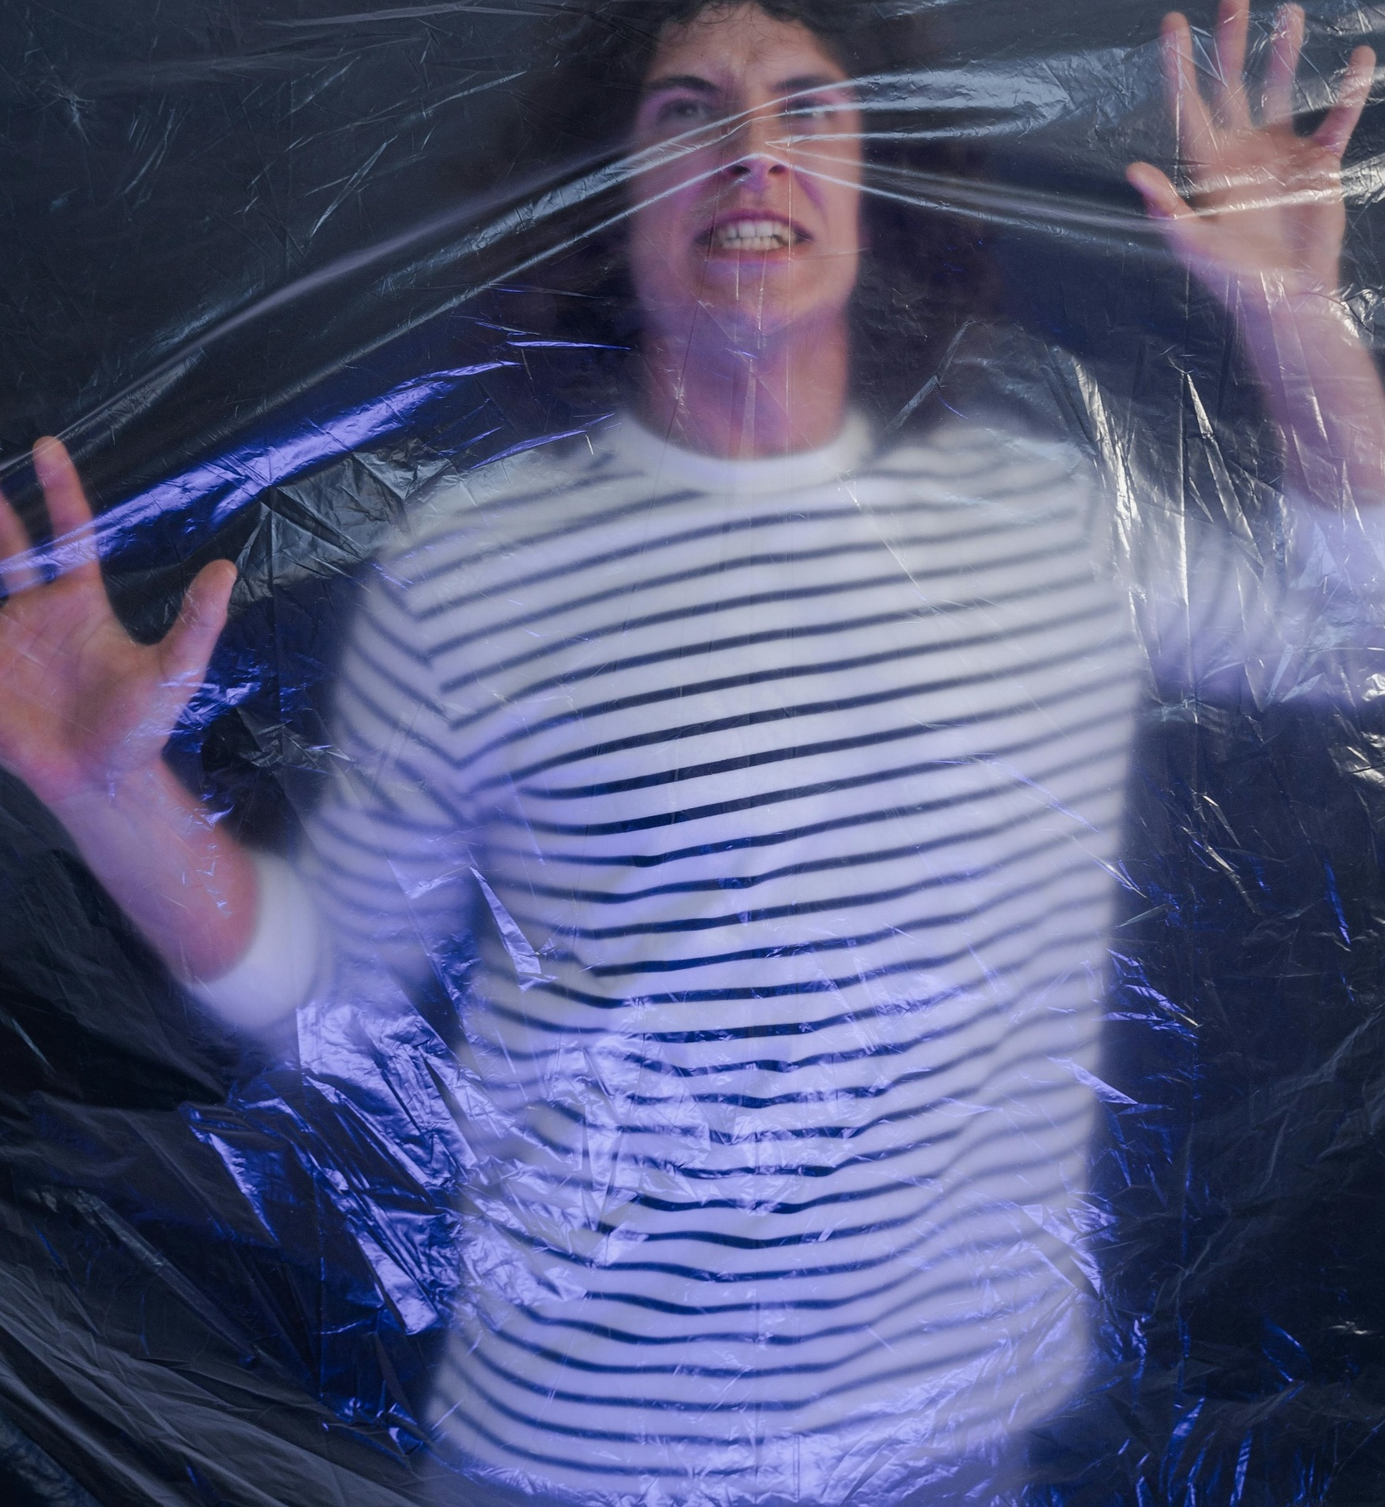
Limitations
Not all students do EPQ
FE librarians not afforded opportunities for skills training in other areas
HE librarians increasingly time-poor
What is the motivation of HE getting involved?
Are HE interfering?
Will have to go through this again at University regardless
Skills-based preparation for HE can actually lessen students’ feelings of readiness (Jansen and van der Meer 2012; Molesworth cited in Jones et al 2023)
Only prepares them for one aspect of library services

Slide 17
A new approach

Slide 18

A mindset-based solution
Shift focus from what HE expects of the student to what students can expect from HE
Less focus on skills development and more on fostering help-seeking behaviours
FE can be seen to have a focus on answering questions, whereas the focus in HE is on students asking questions – BUT there are a number of social barriers to this (Jones et al 2023)
Transition as less of process from A to B and instead as a continuum throughout their academic journey
Successful transition = better retention

Slide 19

Implementing this
Collaboration is key
More students staying local to home strengthens importance of links between FE and HE
Can FE and HE libraries work together to better align services
Move away from recruitment as our motivator, instead focus on retention
Outreach from an independent perspective
Less focus on developing independent learners
Own our expertise
Evidence our impact

Slide 20
Reference List

Slide 21
Reference List
BARRY, M.E., R.J. SNYDER and K.B. MATHUEWS, 2021. Motivations and Challenges of Academic Library Support during the Transition to College. Portal : Libraries and the Academy, 21(3), 511–530
DIPRINCE, E. et al., 2016. Don't Panic! Reference & User Services Quarterly, 55(4), 283–292
GALE, T. and S. PARKER, 2014. Navigating change: a typology of student transition in higher education. Studies in higher education (Dorchester-on-Thames), 39(5), 734–753
GARDIJAN, N., 2021. Library Anxiety: An Overview of Re-Emerging Phenomena. Library Philosophy and Practice, (Winter), 1–31
GILL, A., 2017. The Transitional Experiences of Sport and Exercise Students from Further to Higher Education. Innovative Practice in Higher Education, 3(1), 22–47
JANSEN, E.P.W.A. and J. VAN DER MEER, 2012. Ready for university? A cross-national study of students' perceived preparedness for university. Australian educational researcher, 39(1), 1–16
JESSEN, A. and J. ELANDER, 2009. Development and evaluation of an intervention to improve further education students' understanding of higher education assessment criteria: three studies. Journal of Further and Higher Education, 33(4), 359–380
JONES, H. et al., 2023. Transition into higher education. St Albans: Critical Publishing
KENDALL, A., M. KEMPSON and A. FRENCH, 2018. 'How will I know when I'm ready?’ Re-imagining FE/HE 'transitions' as collaborative identity work. Research in Post-Compulsory Education, 23(1), 41–56
MELLON, C.A., 1986. Library Anxiety: A Grounded Theory and Its Development. College & Research Libraries, 47(2), 160–165
SHAO, X., 2023. The Class of 2023: Opportunities and University Plans [viewed 18 July 2024]. Available from: https://cosmostudy.uk/publications/the-class-of-2023-opportunities-and-university-plans
THE GUARDIAN, 2023. One in three of England’s university starters ‘may live at home’ this year [viewed 18 July 2024]. Available from: https://www.theguardian.com/education/2023/aug/10/one-in-three-of-englands-university-starters-may-live-at-home-this-year#:~:text=Before%20the%20pandemic%20about%2020,studying%2C%20including%20older%20mature%20students.
THOMPSON, E., 2023. Preparing sixth-form students for the transition into higher education: developing key research skills through the EPQ. Journal of learning development in higher education, (29),
UNIVERSITY OF CENTRAL ARKANSAS, 2024. UCA Library Survival Guide [viewed 13 November 2024]. Available from: https://uca.libguides.com/survivalguide_2024/home

Slide 22


Thank you
Mike Jones
Mike.jones@solent.ac.uk
@ThatLibraryMan
@michaeljjoneslibrary

