Slide 1
Exploring how emerging open science services can enhance institutional publication data
Christopher Daley and David Walters
Notes:
ON START –
Put API key in chat box
Open following web pages:
1)
2)
3)

Slide 2
Contents
UK Policy landscape
UK OA Policies
Possible concerns
Global policy stack
Technology landscape
Global research services & OA data sources
Representational State Transfer (REST)
JSON (JavaScript Object Notation) & Sherpa REF API
CORE (COnnecting Repositories) API
Global OA and Research Landscape
The ‘state of OA’
Brunel research using open science services
Background
Methodology
Data and Results

Slide 3
Learning outcomes
Wider understanding of current OA policies in the UK.
An overview of some major services that aggregate global OA data and the methodologies used for data capture.
An understanding of institutional systems used for open access compliance and related issues around interoperability with external systems.

Slide 4
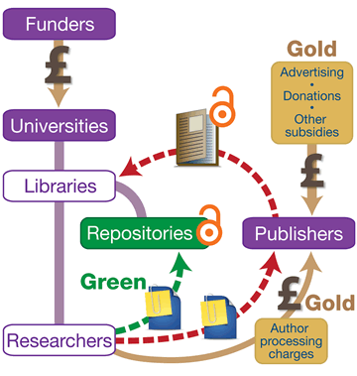
UK policy landscape
2012 – Finch Report – recommended support for ‘Gold’ Open Access.
UK Research and Innovation (Research Councils) strongly prefer Gold for their funded research.
A number of charities (eg. Wellcome Trust) mandate Gold.
Research England (formerly HEFCE) requires all researchers to follow the ‘Green’ Open Access route to remain eligible for REF 2021.
Notes:
At the end of this slide – quick mention of the REF
The REF is the system for assessing the quality of research in UK higher education institutions.
Institutions submit their best research outputs and impact case studies and are awarded research funding
It’s a competitive exercise between institutions
For the current REF, to be eligible for submission outputs must meet open access policy requirements of Research England
OA policy only applies to published journal articles and conference papers – expansion to monographs is due in the REF beyond the one in 2021.

Slide 5
UK policy landscape – levels of OA
Universities UK found 37% of UK publications were open access on publication in 2016.
More than half available to view within 12 months of publication (either Gold or Green)
Universities UK. 2017. Monitoring the Transition to Open Access. Online: http://www.universitiesuk.ac.uk/policy-and-analysis/reports/Documents/2017/monitoring-transition-open-access-2017.pdf
Research England report, June 2018.
‘…over 80 per cent of the outputs covered meet the policy requirements, or an exception is known to apply […]. This represents an enormous achievement, contributing to increased access and use of UK research.’
Research England. 2018. Monitoring sector progress towards compliance with funder open access policies. Online: https://re.ukri.org/documents/2018/research-england-open-access-report-pdf/
Notes:
The effects of these policies have been quite noticeable and rapid. Two reports which have recently discovered evidence of this.
UUK found that 37% of UK publications (just journal articles) were OA in 2016 – so this is just simply looking at works which are fully open access on publication.
UUK also found that over 50% of publications were available within 12 months of publication – so for Green publications this would be after an embargo.
Research England very recently – in June this year – found that 80% of outputs complied with their policy for the next REF (you’ll remember they preference the green route) or had registered one of their very generous exceptions.
As they state in their report this is a significant achievement and it is good to see such increases in OA in the UK. However, as staff involved in implementing the policy as well as being OA advocates, we have noticed a number of things about such a mandate and compliance based approach which concern us.

Slide 6
UK policy landscape Some concerns – OA as a tick-box exercise
Notes:
The first worry we have and it is something that we have seen on the ground is that both academics and institutions start to see OA purely in relation to compliance levels.
So, academics often say to us ‘ah yes, I have to make this Open Access so it can be submitted to the REF’, or ‘I can’t be bothered to make this paper OA as I don’t want to submit it to the REF’.
The other concern is that institutions become obsessed with compliance levels – which is understandable given the policy environment – forgetting about the broader aim of open access and open scholarship which involves using open material to widen engagement with publics beyond institutional walls.

Slide 7
UK policy landscape Some concerns – duplication of effort
Notes:
Additionally, we have been quite concerned that in order to comply with government policies on OA, institutions have focused so tightly on their own institutional systems that they have been ignoring the wider OA practices of co-authors or the use of other compliant systems such as disciplinary repositories.
This may then lead to the same task (eg. Depositing in an institutional repository) taking place multiple times for one paper as each co-author is asked to undertake the task by each of their research support services. OA only needs to take place once to ensure compliance.
We will later talk a little bit about our research results and how this shows levels of duplication.

Slide 8
UK policy landscape – recent discussions
To my mind, we rushed in too quickly with policy demands instead of providing the mechanisms by which academic communities could form their own flavour of openness. At that point openness lost the opportunity to become a cultural norm because it then became a compliance issue. Academics did open because they HAD to, for fear of not being REF-submittable or being blacklisted for further funding.
- Elizabeth Gadd. 2018. ‘Measuring openness: should we be careful what we wish for?’ Online: https://thebibliomagician.wordpress.com/2018/08/21/measuring-openness-should-we-be-careful-what-we-wish-for/
However, what is imperative to keep in mind when reading the report is that compliance with a policy is not the end goal of a policy in itself. While clearly the UK policies over the past five years have increased the amount of UK research that is available open access, we do need to ask ourselves ‘so what?’. What we are not measuring, or indeed even discussing, is the reason why we are doing this.
- Danny Kingsley. 2018. The institutions have spoken, Research England Blog. Online: https://re.ukri.org/blog/danny-kingsley/the-institutions-have-spoken/
Notes:
It is interesting to note that a few other prominent figures in the scholarly communication world have also started to express some concerns about the ultimate goal of such policies. Indeed, it is interesting to see people concerned that OA mandates do not necessarily connect with broader cultures of openness or necessarily incentivize academics to develop their own open cultures.
Ultimately, academics are the producers of knowledge and for open scholarship to have a societal impact it needs these academics to be wholly engaged with openness and its potentialities.
Otherwise, as Cameron Neylon said to us at our OA conference at Brunel in 2016, we are simply tossing library books or journals over a campus wall and hoping publics pick them up. Challenge is in breaking down the walls.

Slide 9
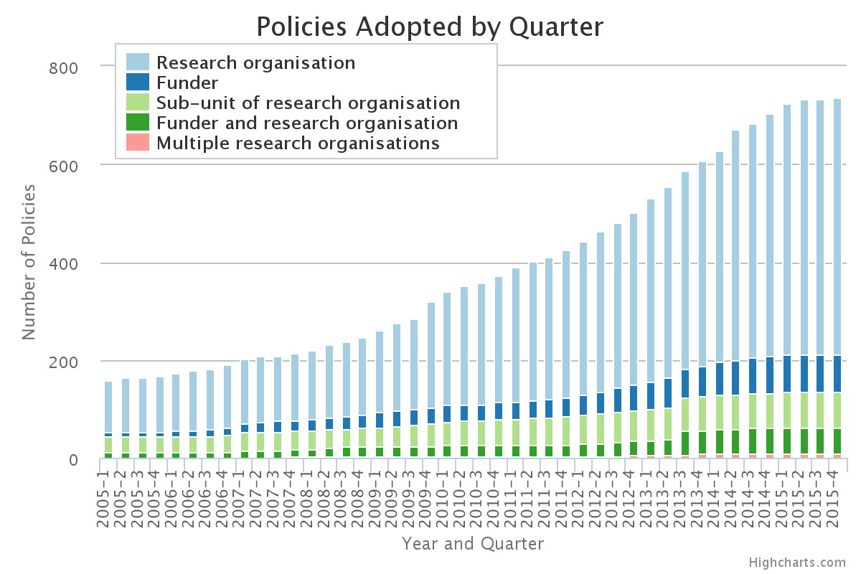
Global OA policy stack

Slide 10
Technology landscape

Slide 11
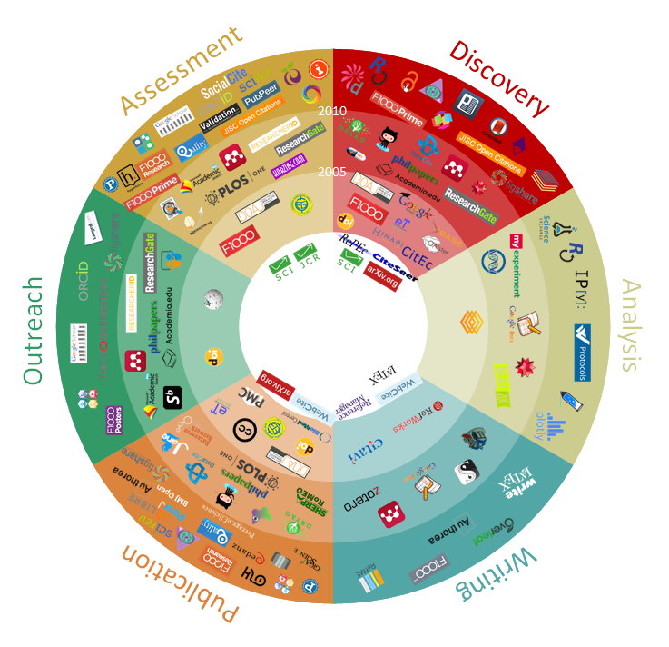
Global research services & OA data sources
101 Innovations in Scholarly Communication: https://innoscholcomm.silk.co/

Slide 12
Global research services & OA data sources
Reproducible research
Open Hardware
Open Education
Open Access
Open science
Open Software
Open Peer review
Open data

Slide 13
What open science services are out there to help institutions identify OA publications and data?

Slide 14
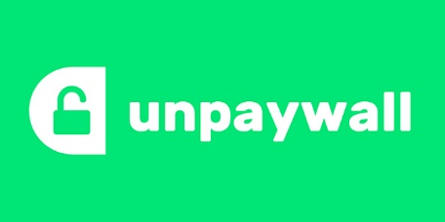
Global research services & OA data sources
Unpaywall: OA classes |  | Primary function | Clients | API
Unpaywall | OA data provider | Identifying OA for published works | Browser extension, Scopus, WoS, others | Yes
CORE | OA data and publication aggregator | TDM services | Web interface, Repository recommender | Yes
Sherpa REF | Journal OA policy provider, REF compliance | REF compliance | Web interface | Yes
Jisc Blog post – ‘CORE becomes the world’s largest aggregator’:
https://scholarlycommunications.jiscinvolve.org/

Slide 15
What is a REST API??

Slide 16
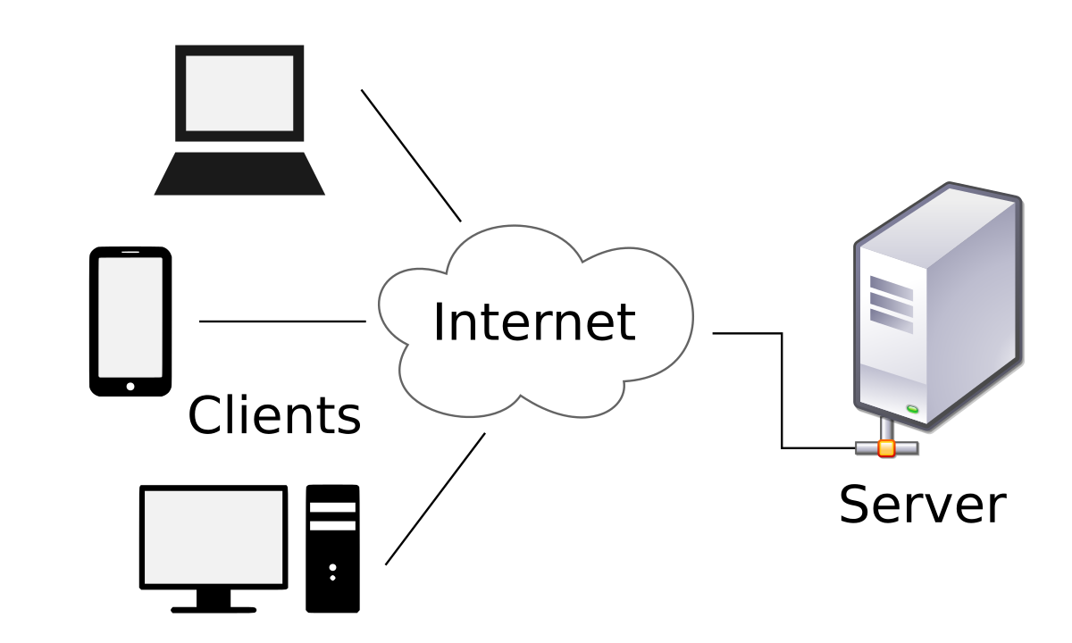
Representational State Transfer (REST)
Architectural style encompassing common web standards (e.g. HTTP, URL, HTML and XML).
Accessing resources from a REST API is much like requesting a web page from a web server
Client-Server
REST retains benefits of the ‘design’ of the web in terms of: loose-coupling, scalability, open-standards-based and vendor-independent technologies

Slide 17
Representational State Transfer (REST)
An architectural ‘style’ or approach, not a standard (unlike SOAP, which is a W3C standard)
RESTful standards make data available for machines as well as humans.
REST is a term originally coined by Roy Fielding in his PhD dissertation. In Fielding’s own words:
“The name ‘Representational State Transfer’ is intended to evoke an image of how a well-designed Web application behaves: a network of web pages (a virtual-state machine), where the user progresses through the application by selecting links (state transitions), resulting in the next page (representing the next state of the application) being transferred to the user and rendered for their use.”
Stateless – each request has to complete, carrying all required info to process request
Standard HTTP operations (GET, PUT, POST, DELETE)
Resources uniquely identified by URIs
Software components, e.g. clients, manipulate resources. One resource might contain URIs to other related resources
Fielding, R. T. (2000) Architectural Styles and the Design of Network-based Software Architectures [Online], University of California, Irvine, Section 6.1. Available at https://www.ics.uci.edu/ ~fielding/ pubs/ dissertation/ evaluation.htm#sec_6_1 (Accessed 9 June 2018).

Slide 18
Representational State Transfer (REST)
Operationally, REST is not at all concerned with how it is implemented.
Rather, based on ‘resource’ concept
A resource is defined by own unique address/representation
a client requesting any URI receives a response that places the client in either a new or a refreshed state
Key Concepts:
State (HTTP response – page/content)
Transition (another state accessible from the current state, e.g. a URI available in the current state)
Transport protocol (simply HTTP)

Slide 19
Representational State Transfer (REST)
Lightbulb moment
http://www.example.com/lightbulb
Consider the case of a light switch that wants to convey to the light whether to be ‘on’ or ‘off’.

Slide 20
Representational State Transfer (REST)
Light ON
PUT "true" to http://www.example.com/lightbulb
Light OFF
PUT “false" to http://www.example.com/lightbulb
Check the state of the resource
GET http://www.example.com/lightbulb
Return data, e.g. true/false
Notes:
As the on/off instruction is a simple Boolean ‘true’ or ‘false’ value, we can use a standard HTTP PUT method to send requests to the light:
To turn the light off, we can use:
PUT "false" to http://lightbulb.example.com/on
To determine whether the light is on or off, we can then use a standard HTTP GET method:
GET http://lightbulb.example.com/on
(which returns either "true" or "false").

Slide 21
Representational State Transfer (REST)
REST summary
A stateless methodology or style
Transported via HTTP or HTTPS
Request is transported as a URI
Response data can be XML, JSON or other text-based methods
Analysis of URI and HTTP method indicate intent
Notes:
To summarise

Slide 22
SHERPA REF
https://ref.sherpa.ac.uk/api
Pass an ISSN or EISSN to access the resource
Example - Nature
Notes:
Nue1ETJYfAih2DQ8OPRvwgsMxVl56pyz
Look up article from dataset
Look up doi from dataset
Enter into article search (query)
Look at result

Slide 23
What’s Json?
And…

Slide 24
JSON (JavaScript Object Notation)
JSON commonly used as a web services tool to read and retrieve data from a web server and display that data within a web application, or simply a web page.
JSON is a standard and it is maintained by http://www.json.org/ .
JSON as a lightweight data-interchange format that has been widely adopted
an alternative data-interchange format to XML
JSON’s advantages are that it tends to be more compact than XML, understands JavaScript, and some would argue that it is easier to read and write
JSON has close links with Javascript - easy conversation to native JavaScript objects

Slide 25
CORE (COnnecting Repositories)
An aggregation service with more than a thousand data providers
CORE aggregates open access journals and repositories (subject and institutional)
The collected data are available to everyone via the CORE search engine
Supports text and data mining of the aggregated content via the API and the Data Dumps
Provides a recommendation tool for repositories and journal software

Slide 26
CORE (COnnecting Repositories)
https://core.ac.uk/docs/
Register for the API
You’ll receive an API key parameter which is common to all API methods
For all API methods the API key can be provided either as a query parameter or in the request header.
Demo CORE API with Results from Brunel research (example paper)
https://figshare.com/articles/CORE_SQL_query_and_data_sample/5799336
JSON viewer
http://jsonviewer.stack.hu/
Notes:
Nue1ETJYfAih2DQ8OPRvwgsMxVl56pyz
Look up article from dataset
Look up doi from dataset
Enter into article search (query)
Look at result

Slide 27
Results
CORE records contain additional geolocation data, enabling physical host locations to be plotted on a map.
https://drive.google.com/open?id=1J1BZvySYDwC32nHm6grsuojgatPmuKYy&usp=sharing
highest concentration of OA locations is in European territories and within the UK
370 distinct works in multiple OA locations
One paper was found in 9 separate OA locations. A comparison with Google scholar found 24 OA locations
CORE found 1894 OA locations for 1073 distinct publications
Notes:
Returning to the metaphor of the telescope we are looking outward from
4/7 – you can see combination of values – version, oa route, and repo type

Slide 28
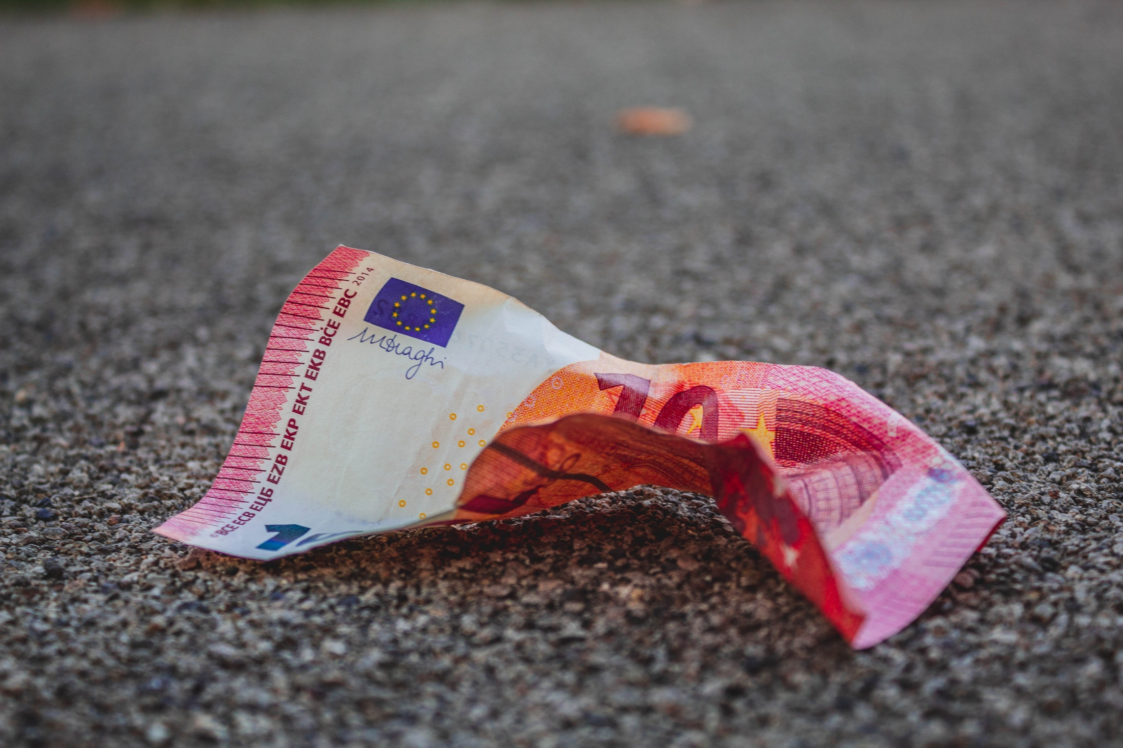
Global OA landscape

Slide 29
The ‘state of OA’
Unpaywall, launched late 2016, is a database of over 20 million open access articles. Unpaywall also offers a free browser extension and a free API that is used in thousands of academic libraries and handles over 1.5 million unique uses daily
Piwowar, H.; Priem, J.; Larivière, V.; Alperin, J.P.; Matthias, L.; Norlander, B.; Farley, A.; West, J.; Haustein, S. The state of OA: A large-scale analysis of the prevalence and impact of Open Access articles. PeerJ 2018, 6, e4375.
45% of recent scholarly works were found to be legally available through Gold or Green publishing models
At the highest level, Piwowar and Priem (et al.) define OA as ‘free to read online, either on the publisher website or in an OA repository’ and ‘all articles not meeting this definition were defined as Closed’

Slide 30
The ‘state of OA’
Unpaywall: OA classes
Gold: Published in an open-access journal that is indexed by the DOAJ (Directory of Open Access Journals—a directory indexing open access peer-reviewed journals).
Hybrid: Free under an open licence in a toll-access journal.
Bronze: Free to read on the publisher page, but without a clearly identifiable licence.
Green: Toll-access on the publisher page, but there is a free copy in an OA repository.
Closed: All other articles, including those shared only on an Academic Social Network or in Sci-Hub.
Notes:
45% of recent scholarly works were found to be legally available through Gold or Green publishing models
At the highest level, Piwowar and Priem (et al.) define OA as ‘free to read online, either on the publisher website or in an OA repository’ and ‘all articles not meeting this definition were defined as Closed

Slide 31
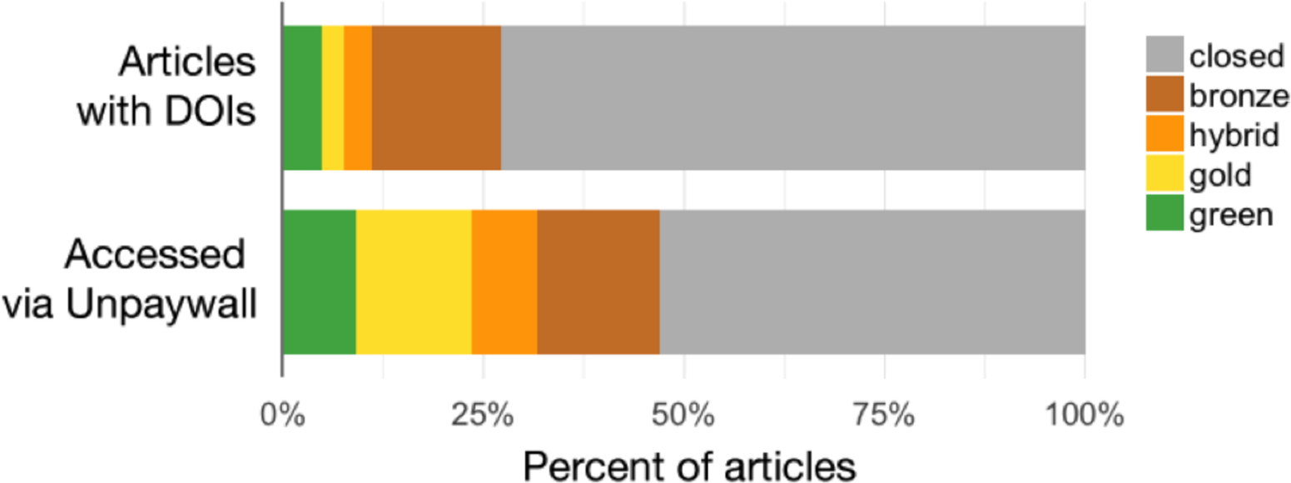
The ‘state of OA’
Percent of articles by OA status, Crossref-DOIs sample vs Unpaywall-DOIs sample.
DOI: 10.7717/peerj.4375/fig-1
Unpaywall also have an API and client services for monitoring OA – institutions should make good use of it
Unpaywall is fast becoming the best source of identifying OA information for a publication

Slide 32
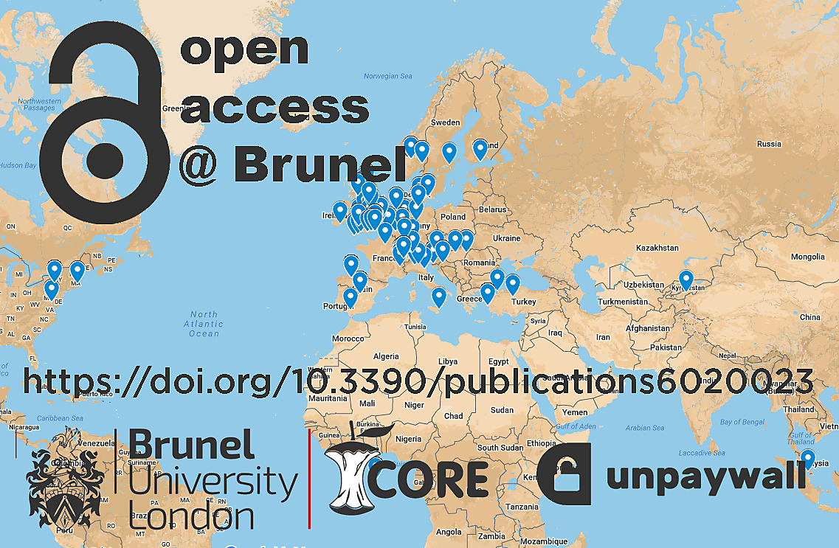
Brunel research utilising open science services (2018)
Notes:
In our research we waned to explore whether the policy and technolgoy environment

Slide 33
Aims
Create OA classification schemes to interpret the data
Investigate possible OA locations (Sherpa REF).
Investigate OA locations (CORE)
and plot the geolocation of Brunel works (CORE).
Investigate OA locations and volume (Unpaywall / CORE) resources.
Looking beyond institutional systems to the collaborative OA environment
Notes:
Returning to the metaphor of the telescope we are looking outward from

Slide 34
V
Results – Intersection of OA locations and research collaboration
Notes:
Returning to the metaphor of the telescope we are looking outward from
4/7 – you can see combination of values – version, oa route, and repo type

Slide 35
Results
Sherpa REF data highlights the scale of possible OA locations available to authors when making dissemination decisions for their research
The service covered 84% of serials in the sample that had an ISSN or EISSN.
the most common OA location is the archiving of an accepted manuscript into an institutional repository. The results demonstrate that many publisher policies align with the requirements of UK funding bodies
However, the data shows 34 total OA scenarios for authors
https://figshare.com/articles/Sherpa_REF_SQL_query_and_data_sample/5799339
6% of journal titles had 8 or more possible OA locations available to authors
Notes:
Returning to the metaphor of the telescope we are looking outward from
4/7 – you can see combination of values – version, oa route, and repo type

Slide 36
Results
Count | Sherpa REF Results
1 | Archive, Accepted Version, Author Website
2 | Archive, Accepted Version, Department website
3 | Archive, Accepted Version, Institutional Repository
4 | Archive, Accepted Version, Other
5 | Archive, Accepted Version, Disciplinary repository
6 | Archive, Published Version, Author Website
7 | Archive, Published Version, Department website
8 | Archive, Published Version, Institutional Repository
9 | Archive, Published Version, Other
10 | Archive, Published Version, Disciplinary repository
11 | Hybrid, Published Version, Author Website
12 | Hybrid, Published Version, Institutional Repository
13 | Hybrid, Published Version, Disciplinary repository
open access dissemination options for the Journal of Applied Physics (AIP Publishing).
Notes:
A small number of publications had as many as 13 possible OA locations
The results may indicate that authors are engaged in many OA workflows, given the availability of options per publishing policy. The number of institutions and authors involved in collaborations may increase this possibility. We conclude that the complexities and range of publisher policies, combined with funder and institutional policies, may create opportunities for duplication in OA locations.

Slide 37
V
Results – Volume and scope of OA locations
Notes:
Returning to the metaphor of the telescope we are looking outward from
4/7 – you can see combination of values – version, oa route, and repo type

Slide 38
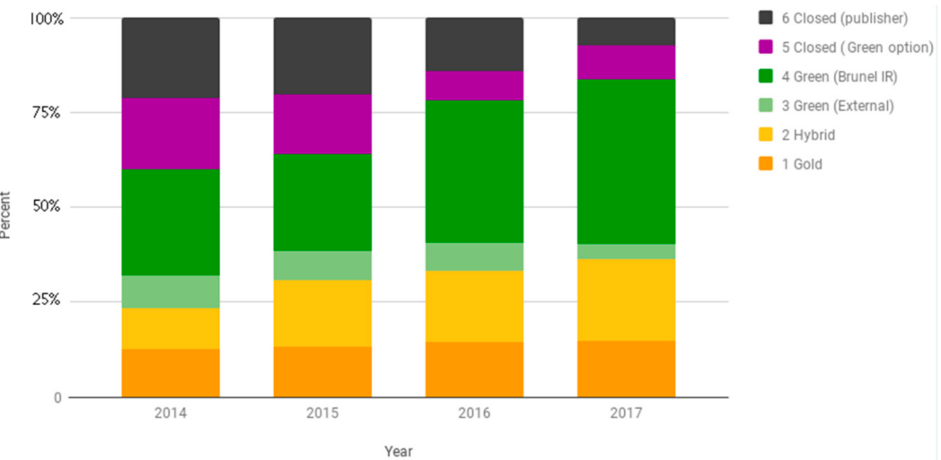
Results
‘best available’ OA classification scheme
Increased levels of Gold and Green OA
Notes:
Returning to the metaphor of the telescope we are looking outward from
4/7 – you can see combination of values – version, oa route, and repo type

Slide 39
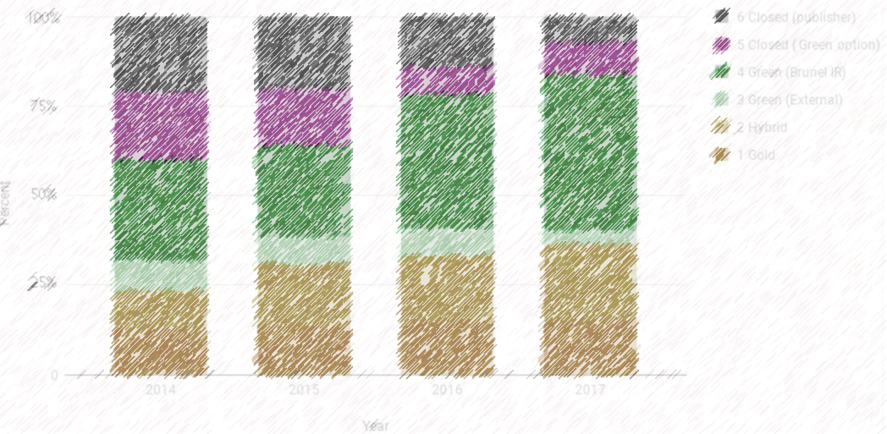
Results
‘best available’ OA classification scheme
The ‘gap’ to OA – just 7% of outputs with a green option

Slide 40
Results
‘best available’ OA classification scheme
Growth in Hybrid, stabilisation of Gold
Notes:
Returning to the metaphor of the telescope we are looking outward from
4/7 – you can see combination of values – version, oa route, and repo type

Slide 41
V
Results – Replication and multiplicity
Notes:
Returning to the metaphor of the telescope we are looking outward from
4/7 – you can see combination of values – version, oa route, and repo type

Slide 42
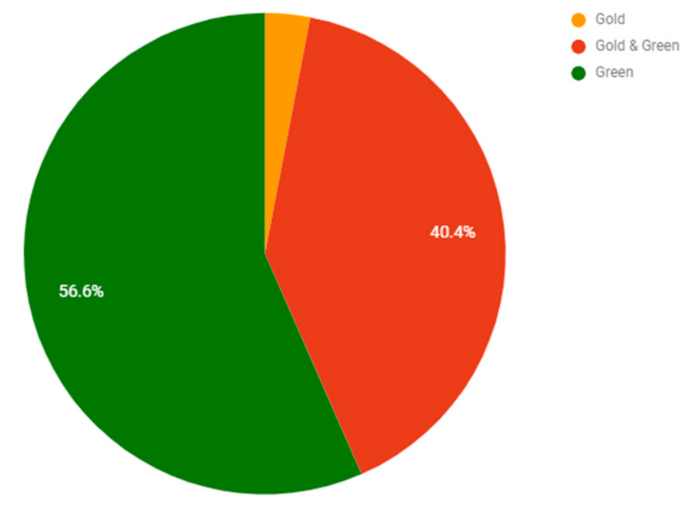
Results
Most Gold is found in other locations, irrespective of licence conditions
Notes:
Returning to the metaphor of the telescope we are looking outward from
4/7 – you can see combination of values – version, oa route, and repo type

Slide 43
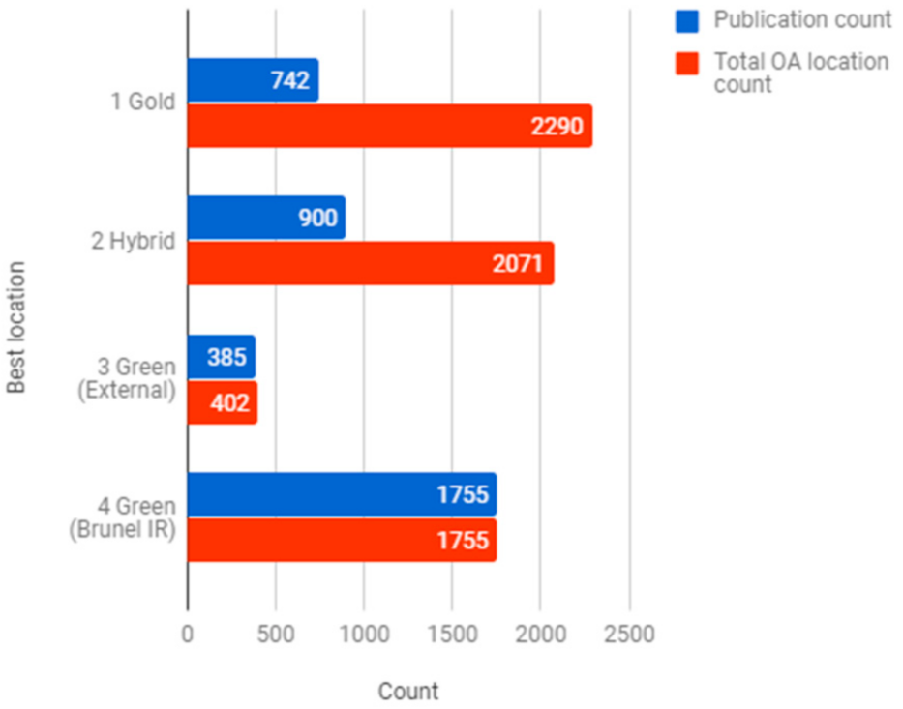
Results
Green is the most popular form of OA, with the least replication
Notes:
Returning to the metaphor of the telescope we are looking outward from
4/7 – you can see combination of values – version, oa route, and repo type

Slide 44
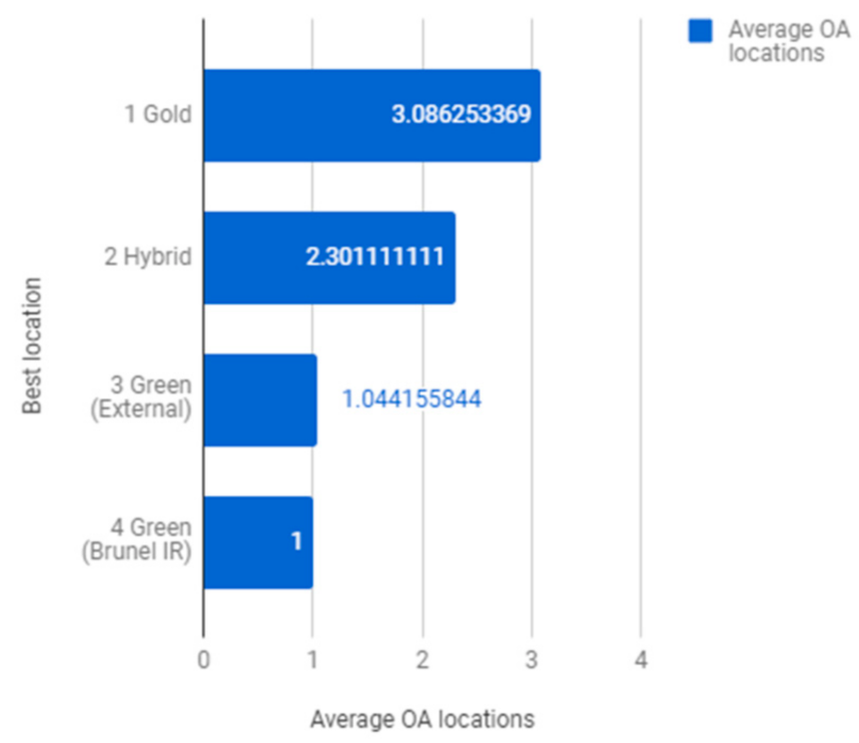
Results
Gold is replicated more than Hybrid

Slide 45
Research findings
Global research collaboration
National policy requirements
Institutional compliance levels
Notes:
At the broadest level, our research has highlighted a tension between the reality of research as a highly collaborative enterprise, with partnerships that cross institutional and territorial boundaries, and the requirements of nationally focused policies, which tend to force institutions to monitor their OA compliance narrowly through their own local institutional systems.

Slide 46
Research findings
Kramer, Bianca; Bosman, Jeroen (2015): 101 Innovations in Scholarly Communication - the Changing Research Workflow. figshare. Poster. Online: https://doi.org/10.6084/m9.figshare.1286826.v1
Notes:
As we have discussed, this is potentially at odds with a transforming and multifaceted open science environment which comprises of a vast network of repositories, social systems, and open initiatives by new and longstanding publishers, which is not easily captured within local systems (this excellent graphic by Kramer and Bosman demonstrates this complexity).
The results of our research therefore point to the need for interoperability between local systems and emergent open science services which are attempting to aggregate OA activity.
Such enhanced data may then help to transform the policy landscape and incentivise researcher or discipline specific activities surrounding open scholarship.

Slide 47
The future? Plan S
Target:
“After 1 January 2020 scientific publications on the results from research funded by public grants provided by national and European research councils and funding bodies, must be published in compliant Open Access Journals or on compliant Open Access Platforms.”
Ten principles (including):
Authors retain copyright of their publication with no restrictions. All publications must be published under an open license, preferably the Creative Commons Attribution Licence CC BY.
The Funders will ensure jointly the establishment of robust criteria and requirements for the services that compliant high quality Open Access journals and Open Access platforms must provide;
The ‘hybrid’ model of publishing is not compliant with the above principles
When Open Access publication fees are applied, their funding is standardised and capped (across Europe)
Full details here: https://www.scienceeurope.org/coalition-s/
Notes:
Before we finish, it is also worth quickly mentioning a very recent announcement by the EU. UKRI has signed up to this, so we are to assume these principles will apply to the UK
A number of things may have already jumped up at you:
Short time for implementation – 1st January 2020, just over a year’s time.
Loaded term ‘high quality’ journals used here – how will they determine quality
Action on the ‘hybrid’ model, a model which has always been controversial and our research showed a significant rise in this model in recent years.

Slide 48
Plan S Initial questions
…I think this is one of the stronger funder-based policies in Open Access that has been committed to in recent years, and they should be applauded for that. So one of the key weakness for me is again the focus on APC-driven Open Access. This is just one part of a complex ecosystem, such as green OA (or self archiving) which is free for authors, and would also motivate the improvement and connectivity of existing library/institutional infrastructure and subject repositories.
- Jon Tennant. 2018. Full comments about ‘Plan S’ and the future of Open Access in Europe. 6th September. Online: http://fossilsandshit.com/full-comments-about-plan-s-and-the-future-of-oa/
…who decides the level of the cap? What does this mean for policies on green open access, where publications from subscription journals are placed in open repositories sometimes after an embargo period? How will smaller institutions whose libraries lack the funding to cover article processing charges comply?
- Martin Eve. 2018. Dial S for strategy. ResearchResearch. 5th September. Online: https://www.researchresearch.com/news/article/?articleId=1376978
Notes:
Some interesting initial questions from Jon Tennant and Martin Eve.
Both are generally supportive of the plan, with Eve concluding that ‘Plan S is a bold, radical vision for the future of scholarly publishing. It adopts a deliberately interventionist strategy designed to allow the payers to call the pipers’ tunes.’
We broadly agree with this and feel that Plan S is bold in trying to curb some publisher practices around hybrid which have become unsustainable for institutions, and in particular libraries.
Couple of other questions emerge however:
Very science focused, what about arts, humanities and social sciences? Will soon apply to monographs, so may ultimately help shake up this area of scholarly publishing.
Quite top down again – compliance focused. Where is the incentive do engage in cultural shifts towards open scholarship which is not just centred on traditional publishing methods?
Positive that there is one regional policy with consortium of national funders signing up - improvement on lots of localised ones. But what does this mean for these individual national policies?
I’m sure these questions will be answered in the coming weeks, but we thought we would squeeze this in at the end as we know it is a pressing issue.

Slide 49
Thank you! Any questions?
Further reading:
Piwowar, H.; Priem, J.; Larivière, V.; Alperin, J.P.; Matthias, L.; Norlander, B.; Farley, A.; West, J.; Haustein, S. The state of OA: A large-scale analysis of the prevalence and impact of Open Access articles. PeerJ 2018, 6, e4375. [Google Scholar] [CrossRef] [PubMed]
Martín-Martín, A.; Rodrigo Costas, T.; Emilio, D. Evidence of Open Access of Scientific Publications in Google Scholar: A Large-scale Analysis. ArXiv 2018. [Google Scholar] [CrossRef]
Walters, D.; Daley, C. Enhancing Institutional Publication Data Using Emergent Open Science Services. Publications 2018, 6, 23. DOI: https://doi.org/10.3390/publications6020023
Follow us on Twitter:
@cr_daley
@_DavidWalters

