Slide 1
Surveys, Statistics, Narrative: Communicating Library Value to Administrators
Notes:
Surveys, Statistics, Narrative: Communicating Library Value to Administrators
Hello – and thank you for joining us today. I’m Caroline, and I’m the Library Marketing Manager for Taylor & Francis.
This is my co-presenter, Harriet who is the Senior Manager for our Research and Analytics Team
In today’s presentation, we are going to explore the librarian’s narrative and the tools librarians use to craft their story through surveys and statistics and communication initiatives & how they present this information to key stakeholders within the library & beyond.
We will be drawing on findings from the Taylor & Francis White Paper: Surveys, Statistics, Narrative: Communicating Library Value to Administrators and will look at:
Perceptions of value- how value is perceived by the librarian and the administrator
How librarians capture data
We will explore customer experience methodology
Usage data: the impact, ambiguities and implications of COUNTER
How librarians present and communicate the value of their library
Reflections & Take-aways

Slide 2
What is value?
Notes:
Taylor & Francis published the White Paper: Surveys, Statistics, Narrative: Communicating Library Value to Administrators in 2017. This looked at how librarians communicate value to their decision makers.
We surveyed over 250 librarians, the majority of whom came from the US. We also conducted in-depth interviews and ran focus groups to better understand our customers and the pressures they face in delivering their services to draw together voices from the research community.
We want to share some ideas, insights from the survey.
We are also going to look at how librarians have been demonstrating value to the community they serve, as well as giving you insights into approaches to customer mapping that we find useful in shaping our messaging.
We hope you may find all of this useful when delivering your own story about the value of your library.
First and foremost- what is value?

Slide 3
What is value?
‘Part of the issue is to figure out how to best express – how to define – what value means. Value to what? Value to faculty research success? Value to student success? Value to student learning? Because all of those have very different definitions, and use different metrics and tools to describe them. So, how you express value, in many ways, depends on who you’re talking to and what you’re talking about.’
Notes:
I think the question of value is neatly summarised by one of the participants of our focus group, the head of Collection and Research at an American University:
‘Part of the issue is to figure out how to best express – how to define – what value means. Value to what? Value to faculty research success? Value to student success? Value to student learning? Because all of those have very different definitions, and use different metrics and tools to describe them. So, how you express value, in many ways, depends on who you’re talking to and what you’re talking about.’
In our White Paper, we asked respondents several questions about how they define value and how librarians, their institutions and administrators measure the value of the library.

Slide 4
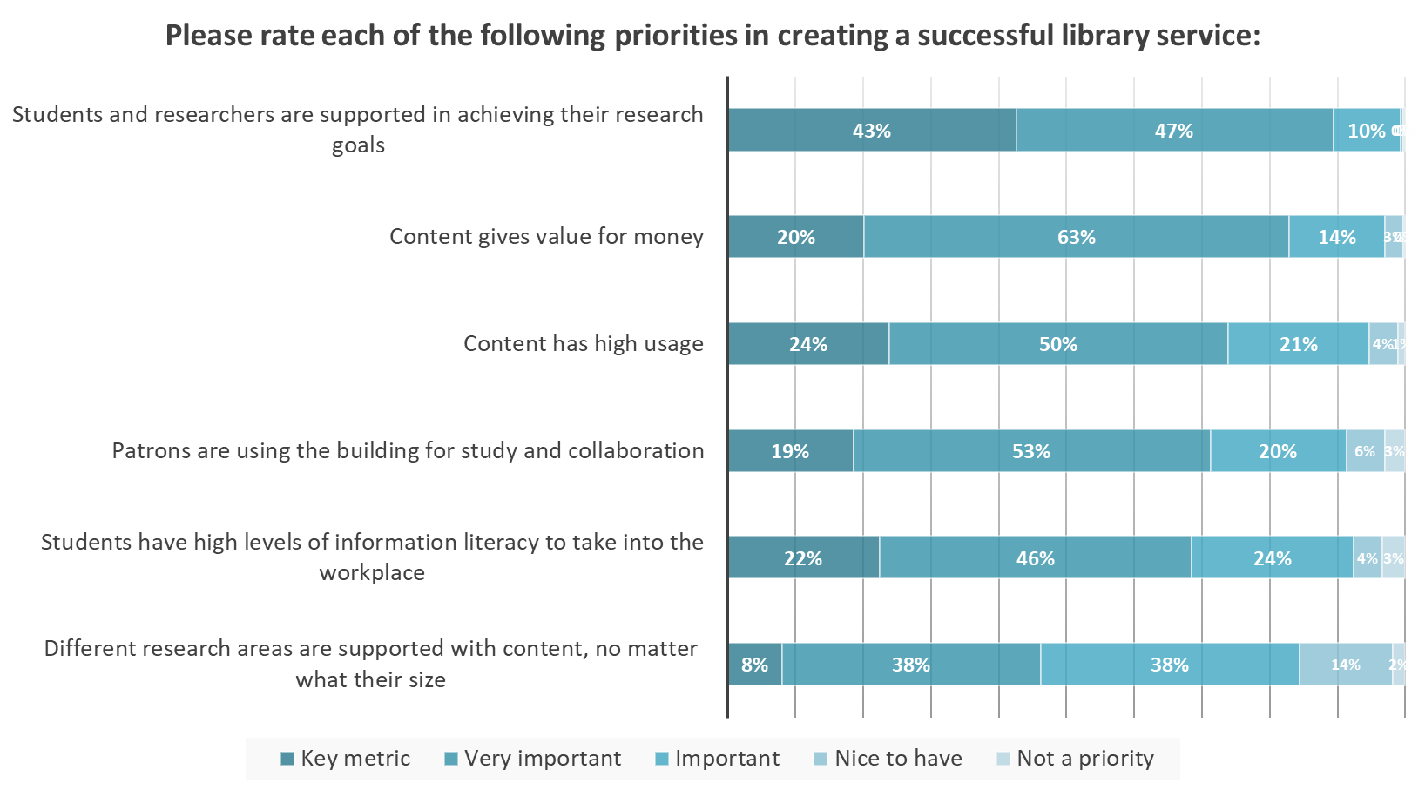
How is value perceived in a library: creating a successful library service
Notes:
We asked about librarians’ priorities in creating a successful library services
Supporting students & researchers in achieving their research goals was rated most important with 89% of respondents rating this as a key metric or very important.
Value for money and high content usage were rated next highest.

Slide 5
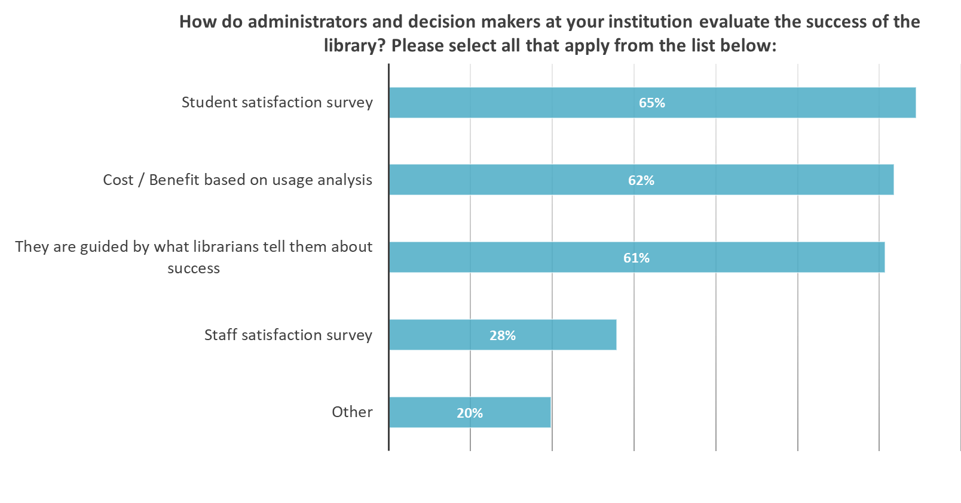
How is value perceived in a library: administrators
Notes:
Librarians were also asked how administrators and decision makers at the institution evaluate success of the library:
65% said student satisfaction surveys were one of the factors used by administrators to evaluate the success of the library
and 62% said cost/ benefit based on usage analysis was used.
This chimes well with the priority ratings in the previous slide.
61% said administrators were partly guided by what librarians tell them about success, which may represent an opportunity for librarians to blend qualitative & anecdotal elements in with the quantitative elements.
Interestingly only 28% said that staff satisfaction surveys were used by administrators to evaluate success, though faculty input was mentioned several times when respondents were asked about other factors used, so maybe this input is collected in a less formal way to that of students.

Slide 6
Usage Statistics
Notes:
Though not the only factor, high usage and a good value for money based on this were highly rated in terms of their importance to assessing the value of a library.
One librarian when interviewed commented,
‘If usage is high, we use that as a credible proxy for saying that we supplied good content, taking the assumption that if it is being used it must be useful.’
I am going to handover to Harriet. She will be talking to us about how usage journeys vary across platforms, and how COUNTER 5 is applying these learnings to continue to assist librarians and publishers with assessing usage.

Slide 7
COUNTER Usage Reporting on Different Platforms
Are we comparing apples to oranges?
This Photo by Unknown Author is licensed under CC BY-NC-ND
This Photo by Unknown Author is licensed under CC BY-SA
Notes:
Thank you Caroline.
When we look at COUNTER usage reporting, we want to be aware of how usage logic is counting across different publisher platforms and that this may not always be comparable, particularly when making value decisions.

Slide 8
Differing platform journeys
Journals Example
HTML format
PDF format
Platform A counts 2 against article usage
Platform A
Click here to view article
Platform B
User chooses preferred format
Platform B counts 1 against article usage
Notes:
Starting with a Journals example of where different platform journeys can lead to inconsistencies in usage reporting:
On some journal platforms, when users go to access the full content for an article, the site will push them straight to the HTML format. Many users prefer PDF, so will often go on to download this too, which in COUNTER Release 4 is currently counted as 2 against article usage. On other platforms the user can choose the format upfront, meaning that the user only views the content once.
Depending on the platform, a user can experience different journeys that can cause an element of double counting.

Slide 9
Improvements with Release 5
Journals Example
New metrics to address this:
total_item_requests
all article full-content views across all formats
unique_item_requests
unique article full-content views regardless of format
Notes:
To overcome these inconsistencies in differing platform journeys, Release 5 has addressed these format duplications with new metrics of total_item_requests and unique_item_requests.
total_item_requests: Counts all article full-content views across all formats like HTML and PDF. This metric is comparable to the current Release 4 usage count.
unique_item_requests: Counts unique article full-content views regardless of format. If a user views an article PDF and HTML in the same session this would only count as 1.

Slide 10
Improvements with Release 5
Journals Example
HTML format
PDF format
Platform A
total_item_requests = 2
unique_item_requests = 1
Platform A
Click here to view article
User chooses preferred format
Platform B
total_item_requests = 1
unique_item_requests = 1
Platform B
Notes:
Using the same example as before, the new release 5 total_item_request is comparable to the previous release 4 metric, however, the new unique item requests get round this inconsistency across platforms and makes the data more comparable, as it counts the unique views regardless of format within the session, so here the unique count is 1 for both cases.
You may want to consider how value might be impacted by these new metrics. For example, you may choose to report on total_item_requests in future, because it is comparable to the usage in Release 4, even though it might not be comparable across platforms. Or you may decide to use unique_item_requests, which is more comparable across platforms, however could impact your usage counts and therefore perceived content value. If you choose the latter, you may need to re-baseline your value metrics and communicate what this means to senior stakeholders.

Slide 11
Differing platform journeys
eBooks Example
Example: An eBook is downloaded as one entire PDF. The book has 10 chapters.
Platform A: 1 book download (BR1)
Platform B: 10 chapter downloads (BR2)
Notes:
Release 4 also emphasised how different platform journeys can lead to inconsistencies in usage reporting in eBooks:
Example: An eBook is downloaded as one entire PDF. The book has 10 chapters.
Following recommendations from COUNTER, some platforms, like platform A, report this as 1 book download in Book Report 1.
However, other platforms can choose not to publish a Book Report 1, and therefore display this as 10 chapter downloads in Book Report 2, as Platform B has done.
This can then cause quite a large discrepancies when comparing value for money with usage as a metric across publishers.
We frequently receive feedback from librarians about this, one of the most recent being:
From our viewpoint we need usage statistics to be realistic and transparent …we need a realistic comparison to the ebook usage we have had over time and across publishers.

Slide 12
Improvements with Release 5
eBooks Example
Example: An eBook is downloaded as one entire PDF. The book has 10 chapters.
Platform A
Unique_Title_Requests: 1
Platform B
Unique_Title_Requests: 1
Notes:
In Release 5, it will be much easier to compare eBook usage. COUNTER hope that librarians will use the Unique_Title_Requests metric in Release 5 to evaluate eBook usage.
So in our original example here when a book is downloaded in its entirety it will count as 1 Unique_Title_Request across both platforms.
This means that the data will make usage more comparable across all publishers.

Slide 13
Improvements with Release 5
eBooks Example
Example: An eBook is downloaded as one entire PDF. The book has 10 chapters.
Platform A
Total_Item_Requests: 1
Unique_Item_Requests: 1
Unique_Title_Requests: 1
Where section type = book
Platform B
Total_Item_Requests: 10
Unique_Item_Requests: 10
Unique_Title_Requests: 1
Where section type = chapter
Notes:
However, it is worth mentioning that it is still unclear on how item requests will be counted by publishers, and whether in this example some publishers will continue to count item at the chapter level even though the book has been downloaded in its entirety.
We’re working with COUNTER and other publishers for clarification on how they intend to count this.
As we can see here across both platforms the unique_title_request count is the same, as this metric makes it more comparable across platforms. However, for those publishers who used the chapter count logic previously, like platform B in this example, moving to this new unique_title_request may reduce the overall usage count. It is important to note here that nothing has changed in the underlying user behaviour, it is just the logic behind the measures that has changed.

Slide 14
Other Release 5 changes
Terminology:
Requests - viewing or downloading full content
Investigations - actions in relation to a content item or title, including requests
Master reports:
filter and configure reports to create customised views
Notes:
We can see some of the terminology changing, for example:
Requests: which only includes successful requests for viewing or downloading full content
And we will also see the introduction of a new metric called
Investigations: Any action in relation to a content item or title (includes requests) Includes abstracts, supplementary material, citations, downloads
Denials will be staying the same as previously.
There will also be a significant change in reporting, where as well as static predefined reports by COUNTER, there will also be a new concept of Master reports, which are slice and dice reports allowing you to filter and configure to create customised views of usage data.

Slide 15
Transition between Releases
Jan-19
Release 5 mandatory
May-19
Earliest Release 4 can be retired
Jan-21
Release 4 should be retired
Notes:
COUNTER Release 5 reports will be mandatory by January 2019. Providers must continue to supply Release 4 reports until May 2019, at which stage they can only stop providing the reports if Release 5 reports cover the current and previous 2 years. All Release 4 reports will be retired by January 2021. This means that platforms will have differing Release 4 end dates, over a 20 month period.
When COUNTER Release 5 comes, you need to consider whether you will stop reporting on Release 4, or whether you will look at the data in parallel? And consider how the data will change.
For example, if you were to analyse usage data for 2019 and compare it to 2018, how would you go about this? This kind of comparison will depend on the metric you want to use and you may want to think in advance about this and the data may vary from publishers.
Depending on which release you choose, this may impact your usage, and therefore your perceived value metrics, such as cost-per-download.

Slide 16
Preparing for the future
For Journals will you use: |  | For eBooks will you use:
- total_item_requests |  | - total_item_requests
- unique_item_requests |  | - unique_title_requests
- both |  | - both
Consider when using new metrics:
Re-baselining
Informing senior stakeholders
More on COUNTER: https://www.projectcounter.org
Notes:
You will want to consider the following before Release 5 is launched:
How will you report on journal usage in coming years?
Will you use total_item_requests because it is most comparable with release 4,
or will you start to use unique_item_requests which is more comparable across publishers?
Or will you use both?
How will you report on eBook usage in coming years?
Will you use total_item_requests, which depending on publisher logic may or may not be comparable to release 4
or will you start to use unique_title_requests which is more comparable across publishers?
Or will you use both?
If you do start to use the new metrics offered in release 5, even though the underlying user journey hasn’t changed, the value metrics are likely to look lower if you compare it to the metrics used in release 4, so you might want to consider:
applying a new baseline to your figures.
Telling senior stakeholders who review this data about the changes.
For more information on these changes with COUNTER please visit the link on the slide. I will now hand back to Caroline.

Slide 17
Other means of capturing value
Entry & ID Badge Data
Resource integration into course curriculum
Fulfilment of research requests from collection and IL
Loans of physical books
Use of spaces
(e.g. group study areas)
Number of active patrons
#Instruction sessions taught and students taught
Effect of library usage on student GPA
Qualitative data
(stories, examples)
Focus groups
Notes:
Thank you Harriet for those insights.
Beyond the top ranked usage statistics and student surveys our research under-covered a myriad of different types of data than librarians were capturing to access and demonstrate value and to look for ways to improve. Some of these are highlighted here.

Slide 18
Value in supporting research
Notes:
Sometimes the value of data isn’t always visible straightaway. During our focus groups, some librarians shared how they had been gathering data for years and showed how they were starting to use this to their advantage.
One librarian recounts how they had a database that had records of all research consultations conducted with students since the year 2000.
This database listed their program, their topic, how long they spent during the consultation. Before this data was used for accreditation, but now they are using this information and narrating the story differently to say, “Hey, this is how the library has been, for decades, supporting master’s-level research.”
The librarians continues, ‘We’ve had the data forever, but we’ve never felt the urge or the need to tell the story, but now we’re really having to say, well, how is the library supporting all these research efforts, and so we’re being more creative in our storytelling. ‘
Publishers can also help with telling a story to highlight value to research. Our sales manager in the US, Beth Mullen told us about a librarian who was having to review their package deals. Beth supported her with this. Together they conducted extensive research on their university’s research disciplines. Mapped out the 90 research programs spanning Social Sciences and Humanities and Science & Technology offered at that university and highlighted all the journals that matched exactly the courses offered.
She worked out the most beneficial way of providing relevant content to the library that served research priorities at the institution. Through her research she managed to help the university keep relevant content to meet their research needs.

Slide 19
Demonstrating value to library users
‘My campus is growing, it’s diversifying, its metrics are soaring, everything is positive, but our readership is declining. We have more data now to assess the kind of resources that we have. There’s a marketing piece that’s obviously missing. But the libraries are packed and full, and all the channels are operating full-service…’
Notes:
One librarian shared how these other metrics could all be showing positive value-add for the library even in the face of declining usage statistics.
‘My campus is growing, it’s diversifying, its metrics are soaring, everything is positive, but our readership is declining. We have more data now to assess the kind of resources that we have. There’s a marketing piece that’s obviously missing. But the libraries are packed and full, and all the channels are operating full-service…’
How librarians can highlight and demonstrate the value of their resources to users is something else that came up in our research.
If the services are under-used, then what are the options?
One librarian we interviewed asked the question, how do you demonstrate value to library users if they are not aware of what services are available to them? In this instance, there may be a gap between what the library offers and customer perception. How do you bridge that gap? There are lots of resources and services available but if they are not known about, they are not being used and customer needs are not being met.
During our interview with the librarian, she went on to tell us how they invested time and money to inform end users of resources available to them.
The library organised an event where they offered free pizza. 400 people turned up but students would only get to eat their pizza after they had learnt something about the library and services on offer.
Each semester whenever one aspect of their services were promoted at an event, the stats would go up plus more people would be aware of these services as shown when filling out surveys on campus.
This library gave a lot of focus is on outreach to promote their services and the dean and board members appreciated the work. They knew that the $500 spent on free pizza for students, meant that those students would in turn be learning about the value of the library, knowing what is available which would impact positively on the services they used.

Slide 20
How do you know you are meeting expectations when there are gaps?
Define your customer
Collect data
Map customer journey
Rate importance
Compare expectations and reality
Identify gaps
Make changes
Ongoing review
Notes:
At our focus groups we explored other kinds of benchmarking and measurements that were used to demonstrate the value of the library to the people the librarians reported to and looked at what helped them to set the metrics.
One way that Taylor & Francis tries to provide the right value to the end user is by using our customer data. By that we mean really understanding the customers’ needs to identify whether we are fulfilling those needs and expectations.
We wanted to share with you the customer experience methodology that is at the core of our work at Taylor & Francis. This helps us to set benchmarks to present to senior management to help us implement positive change within our organisation.
Customer experience methodology is a way of comparing our customers expectations with reality and identifying the biggest gaps
Customer experience methodology involves:
Defining who your customer is, the expectations of an undergraduate student may be different from a more experienced researcher. Make sure you are collecting data which accurately reflects your customer base
Collection of both qualitative and quantitative data about those customers
Map the customer journey
Find out how important each aspect of that journey is to the customer
Check how much the customer’s expectations match the reality of their experience
Identify the largest gaps and decide how to close these gaps – this could be a change in processes or systems or it might be a case of changing how you communicate with your customers in these areas
Continue to collect data on an on-going basis which will allow you to measure how effective your changes have been.
Customer experience methodology can be used as a type of benchmarking for your institution. You could use it in your library to highlight gaps in the customer experience between what the reality of that experiences is versus what they expected it to be, to most accurately identify what is most important to your customers. Once the biggest gaps have been identified, this data could then be presented to senior management to deliver services shaped by the end users’ needs and expectations.
Customer Experience mapping let you really understand the end-user which can help an organisation/institution to become more customer-centric through ongoing benchmarking and review to make regular changes to make a positive impact.

Slide 21
Communicating value: understanding the audience
Notes:
We have looked at data, how we capture it and explored its value, ambiguities and now we need to look at communication. How do we communicate value?
In the same way it is important to know our customer, when telling a story, it is important to know who our audience is….
One librarian at our focus group summarised this nicely saying,
‘Be clear about what story you want to tell, who your audience is and select the correct tools to support your story… We talk about telling stories in different ways, but you have to tell it to that audience. Telling anecdotal stories to a numbers person doesn’t work. Showing numbers to an anecdotal story person doesn’t work. You have to learn that audience…. ‘

Slide 22
Communicating value: mediums of communication
How do librarians communicate the value of the library within an institution?
Notes:
We surveyed the most popular mediums of communicating value, the top results were:
71% - presentations to management and committees
70% - end of year reports
49% email newsletters
Interestingly, a large majority of respondents admitted to not regularly producing presentations, an indication perhaps that formally communicating the value of the library is only an annual occurrence.
Along with email newsletters, other cited channels used to communicate about the library on a more regular basis included, posters, intranet articles, social media activity, regular events and meetings with faculty.
At Taylor & Francis we find that communication works best when it’s ongoing and so spending time on these more informal methods of communication gets results when showcasing value as it helps to keep our message in the minds of decisions makers.

Slide 23
Communicating value to drive results:
Have you ever used data as an evidence base to win funds for a new project in your institution?
Notes:
This brings us the important question of using data as evidence to gain funding. We asked the question, have you ever used data as an evidence base to win funds for a new project in your institution. Interestingly only 50% of respondents said they had.
However this may partially be a reflection of the underlying sample as in an early question only 44% of respondents said it was their responsibility to make a case for the annual budget and present it to their administrator.
We found this result surprising, and it would be interesting to hear if it rings true for you all.

Slide 24
Communicating value to drive results
‘We recorded student feedback about library space: positive, negatives, ideas, needs; these drove changes to the library space.’
‘We know for instance that noise is a problem for us and we used student provided data to argue for more enclosed study spaces. ‘
Notes:
The librarians we talked to shared some positive outcomes of using data as evidence for funding, some librarians who we interviewed said:
‘We recorded student feedback about library space: positive, negatives, ideas, needs; these drove changes to the library space.’
‘We know for instance that noise is a problem for us and we used student provided data to argue for more enclosed study spaces. ‘

Slide 25
Stats into stories
Notes:
Another librarian who we interviewed told the story of how they were trying to go beyond the traditional figures such as circulation and number of people in the building to gather data to tell their story better. They had created the Learning Commons, an art studio and social space for students, a few years ago. They approached an external donor to secure further funding for a Learning Studio which focused on creativity of video.
They created benchmarks that went beyond the annual reports:
They looked at:
• How many collaborative ventures they had with faculty
• How many publications had mentioned them
• How many groups used their databases
• How many people utilized a particular space or new service
They were then able to go to internal administrators and use Learning Commons and Learning Studio as the basis for creating a Maker Lab.
By collecting a variety of data, one librarian was able to position the story of their library as a place rather than a function. This enabled them to develop a space where students and faculty, no matter their discipline, research-based or practical needs, could use the library. Such maker spaces have proven to generate interest within communities outside of campus.

Slide 26
Conclusion
Notes:
Overall, the picture we saw is that both qualitative and quantitative data are important– with usage, surveys and cost benefit analyses integral pieces of demonstrating library value.
The examples and success stories we’ve explored illustrate that in using a collection of different data points, libraries can make the case for better engagement, collaboration, and the provision of new spaces which go beyond traditional resources.
By effectively demonstrating value, libraries can create narratives that position themselves to run independent projects and develop the library service as a pro active partner.
While the most successful libraries gather metrics, they also think carefully about how to present these as a relatable story.
From offering free pizza and encouraging student engagement – demonstrating value can often be the first step to help develop and enhance library services with impact that will benefit the entire institution. After all, when administration wishes to present the best of their institution, be it to prospective students or potential donors, a campus tour will often begin at the most vibrant centre of learning and research they offer - the library.

Slide 27
Acknowledgements
Thank you to:
INTERVIEWS
Jeffrey Matlak, Collection Development & Electronic Resources Librarian, Western Illinois University
Mark McCallon, Associate Dean for Librarian Information Services, Abilene Christian University Library
Luke Swindler, Collections Management Officer (Davis Library), University of North Carolina Chapel Hill
Alison Scott, Associate University Librarian for Collections & Scholarly Communication, University of California, Riverside
Maria Atilano, Marketing and Student Outreach Librarian, University of North Florida
Lisa Blackwell, Director of Library Services, Chamberlain University
ACRL CONFERENCE FOCUS GROUPS
Zoe Unno, Science and Engineering, University of Southern California
Jessica Whitmore, Archives Manager and Research Assistant, Mount St. Mary’s University
Charles Gallagher, Special Collections Librarian, Mount St. Mary’s University
Julie Shenk, Information Technology Librarian, Mount St. Mary’s University
Emily Mross, Business and Public Administration Liaison Librarian, Penn State University at Harrisburg
Jennifer Dean, Dean of University Libraries and Institutional Technology, University of Detroit Mercy
Ryan Johnson, Head of Collections, Research, and Instruction, Georgetown University
Cynthia Thomes, Reference and Instruction Librarian, University of Maryland University College
Linda Kopecky, Head of Research Services, University of Wisconsin Milwaukee
Julia Gelfand, Applied Sciences, Engineering & Public Health Librarian, University of California, Irvine
Sherry Tinerella, Public Services Librarian & Liaison for Education, Physical Science & Professional Studies, Arkansas Technical University
Teresa Slobuski, Academic Liaison Librarian , San Jose State University
Christine Menard, Head of Research Services, Williams College
Belinda Ong, Director of Reference and Information Services, The University of Alabama in Huntsville
Rachel Cannady, Research and Education Services Librarian, University of Texas at Antonio
Rebecca Graff, Humanities Research Librarian, Southern Methodist University
Brittany Dudek, Instructional Online Librarian, Colorado Community College
Notes:
We are indebted to the input of a large umber of individuals who provided valuable input to inform our white paper

Slide 28
Thank you!
Harriet Joyce: harriet.joyce@tandf.co.uk
Caroline Blake: caroline.blake@tandf.co.uk

