Slide 1
Engagement Analytics: new methodologies for demonstrating value beyond usage
Helen Adey, Resource Acquisitions and Supply Team Manager,
Nottingham Trent University

Slide 2
Content
Wider context of library data driven decision making,
Changing Library Priorities
Engagement Analytics - why do we need them,
Engagement Analytics & library acquisition decisions
Technical Insight
Marketing Insight,
A few NTU examples of changes based on data,
How do we know when we are getting it right?
Where next?

Slide 3
Library Data and decision making
At NTU we are collecting and using a huge amount of data
Resource List data
Survey data
Enquiries
Turnaway and high demand data
Library occupancy data
Cost per use data
Usage, loans, ILLs
Appointments and attendees data
Notes:
Wider context of library data driven decision making. Many libraries are already collecting a large amount of data and using it to drive decisions:
Resource list data - at NTU it drives the majority of our book purchasing decision; plays a part in stock management and serials review processes
Turnaway and high demand data in monitored multiple times per week to try and spot any problems arising or negative customer experiences. It also often drives end of year purchasing decisions so that we but materials that we know our customers have been trying to access
Cost per use - core data for serials review, renewal and cancellation exercises
Appointments and attendees - Which are the popular library training events & what help do our students need
Usage, Loans ILL can help inform stock review, withdrawal and serials review processes
Library occupancy data help inform our requests for more space and decisions about furniture, stock layout and library design
Enquiries - we collect data on how many enquiries are resolved first time to assess the efficiency of our processes; look at commonly asked enquiries in case they can be solved by better signing and guiding.
Survey data - we analysed comments in survey data, use it to improve our services, drive up satisfaction, investigate low scoring areas etc

Slide 4
Changing Library priorities and the need for data driven decision making
Notes:
AS library priorities change and our previous “subject librarian” teams are restructured into more functional teams supporting research or learning and teaching, they are more likely to be involved in higher priority University initiatives such as Skills for success. Increasingly we are using data to inform decision and to fill the gap where previously subject librarians provide expertise

Slide 5
Background - Why do we need Impact & User Engagement Analytics?
Scenarios when conventional usage data alone is not enough
Evidence Based Acquisitions plans - what constitutes “good” usage
eBook short term loan rentals, free if used for fewer than 5 minutes
How would User Engagement Analytics help in decision making and what might engaged usage look like?
Concern that usage counts alone could be misleading; downloaded by not read, look at content page and exit….
More interesting to know for how long has a resource been used, rather than how many times has it been used?
Active engagement types: notes, cut and paste, citations…….?
Notes:
To put the possibly rather vague idea of Impact and User Engagement Analytics into context, I want to start by giving a couple of examples from Nottingham Trent University when my colleagues and I had been looking at what might be termed conventional usage data, and we found that it wasn’t really enough to make decisions about which we could be confident and we couldn’t be sure exactly what they were was telling us.
In 2015, NTU Libraries launched a new service called Your Books More Books, whereby we undertook to supply our final year UG and post grads with any items which we didn’t already stock, within 3 days of them asking. As part of this YBMB service we ran 5 EBA plans and at the end of each plan, we found that each plan had been used differently and our initially deposited funds performed in widely different ways for each one. For one, our deposited funds would purchase all items used 9 times or more; for another plan, the level was set at items used 25 times or more; the 3rd one, we could buy items used 7 times or more and so on. At the time, we couldn’t really work out whether this was something we should worry about, and we had no clear idea of what would be our measure of good usage. In the end, we largely want with what was affordable, but for some of the plans, we didn’t really feel confident about our decisions or whether we had “purchased” the correct things. We have since gone on to adopt more EBA plans from a variety of publishers and again, they have all performed differently
The other strand of the YBMB project was to offer much quicker ILL service, satisfying requests for items not held, by using whatever route was quickest. This including next day British Library supply; Amazon Prime next day and short term eBook rentals. Again at the end of the project, we analysed and reported on what had worked well and what could have worked better. As part of this analysis, we found that a significant number of the short term rental eBooks links that we had sent to our users had been used for less than 5 minutes and had therefore cost us nothing. Again - we couldn’t work out whether this was a good or a bad thing. Its good that we hadn’t paid, but what would be the verdict of our customers who had hardly used the links we had sent them. Were they really unhappy that the book wasn’t what they needed? Were they Ok about it, because they could tick the book off the list of titles that they needed to look at, and could move on to the next item on their list; or were they thrilled because they quickly found the quote or references they needed in no time at all? We simply had no idea.
This started us thinking about what sort of metrics and data WOULD be helpful when trying to make decisions about how well our services are being used and how satisfied our users might be with the services that we had provided. Is there a risk in basing decisions on usage alone? We have probably all borrowed or downloaded a book and returned it unread, or been attracted by an interesting title but a quick look at the contents page is all we need to decide not to read any further. All of this type if use will have been “counted” in Counter reports but wouldn’t demonstrate impact or engagement. So, we started to ask, would it be helpful to understand more about how long a customer used an item for rather than how many times an item has been viewed? Are there some types of measurable usage which really would be meaningful and provide us with better evidence and data on which to base our decision making and service delivery? Around about this time AS approached us with an offer to work with us on developing a suit of user engagement analytics,

Slide 6
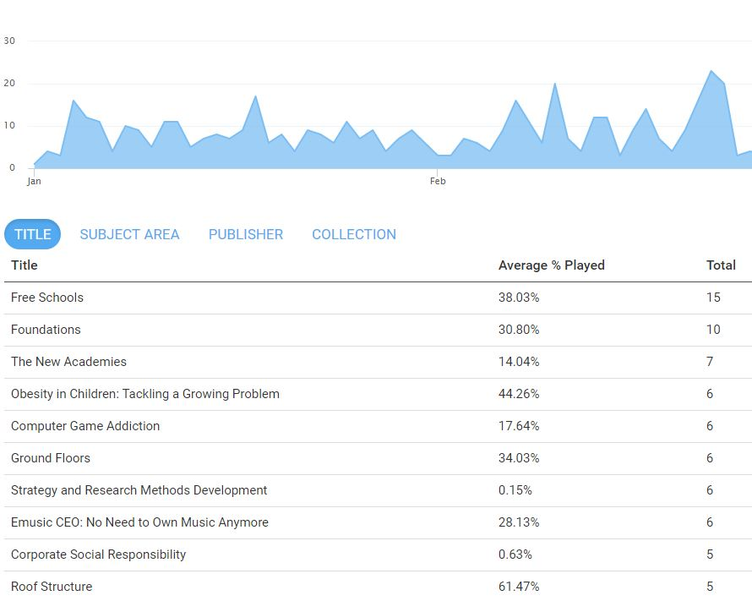
User Engagement Analytics - the Library view: Acquisitions
Much richer view than we get from usage and cost-per-use alone
Most viewed - obvious EBA candidates for final acquisition decisions, but what about “watched for longest” or % played?
Essential when deposited EBA funds don’t run out neatly at a point where all content with the same amount of usage can be selected for retention.
Notes:
NTU has recently concluded our EBA plan with AS and has used these engagement analytics in our decision making. We have found them both fascinating and useful. I’m going to pick out some examples for you that we believe are helpful from an acquisitions point of view (POV); a more technical point of view and finally from a marketing point of view.
Starting with the Acquisitions POV; the first thing to say is that the quality and range of data on offer is much much richer that we find in the normal Counter usage reports. We were thrilled to get a better understanding of how (e.g. in what ways) the resources are being used and for how long. At its heart, we wanted data that we could interrogate to see if the decisions made on content not acquired at the end of an EBA plan was going to come back and bite us- e.g. was there content which may have only been used 6 times, but had been used actively and engaged with, by comparison with other items which had been used 7 times but had been opened and quickly closed. Like most libraries, we would naturally lean towards acquiring the content which had been most used, but we were keen to see if it was possible to see other data and metrics which might be better indicators of how our users have engaged with the content. So, is there any data which shows very active involvement with content provided which might give us some sense of how much it was VALUED by our users. In this slide which shows title views we can see the almost conventional data of most used items in descending order but we can also see on average, how much of the content was played. It is interesting to see here that the item with the largest average % played is not the most viewed title – so if the decision was made to only acquire the top 3 most viewed titles - would we be in danger of rejecting some items which had been viewed for longer or more of their content had been looked at - albeit not as many times? This type of information played a significant part in our end of EBA plan decision making and helped us to make much more informed decisions.

Slide 7
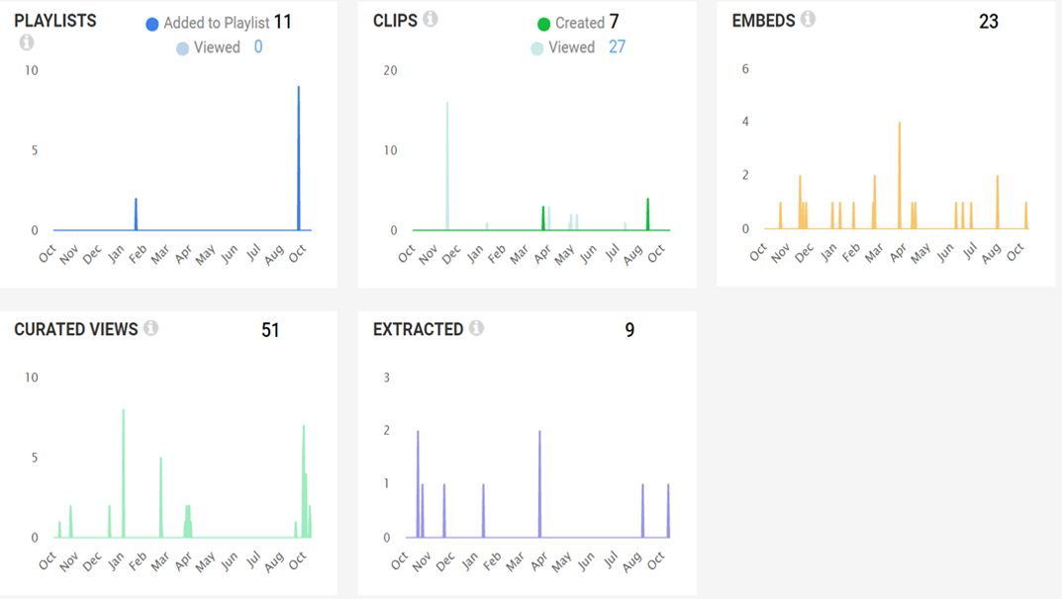
Alexander Street Engagement Summary Screen
Notes:
these are the types of reporting that we can see in the engagement analytics and from an Acquisitions point of view, we feel that all of these have value. An item which has been cited suggests both importance and value; Someone liking content so much that they shared it; or added it to a playlist; watched it on their mobile; clipped bits of content and maybe added to their resource list or embedded it in some sort of learning content, emailed; saved or printed it, all suggest some level of engagement and interest in the content we have made available. We feel that all of these types of metrics have the potential to give us useful insight on which to make our decisions.

Slide 8
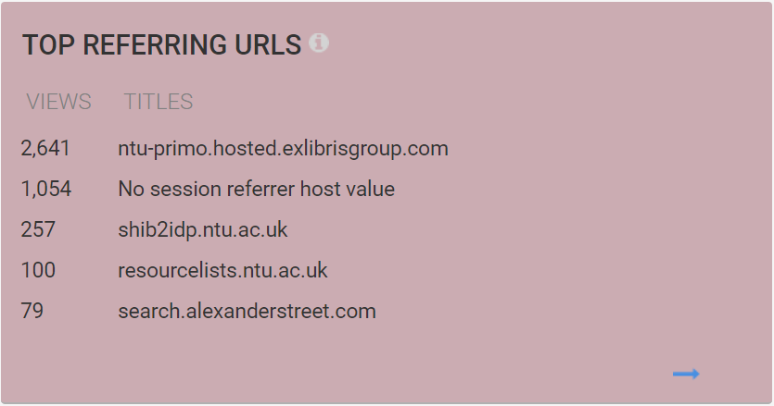
User Engagement Analytics - the Library view: 2 - Technical
Reassuring Top referring URL data - Library’s Resource Discovery system way out in front – supports practice of loading Marc records whenever possible
Notes:
Moving on to some of this “technical” data that we find useful and interesting:
Firstly we were thrilled about this data on the top referring URLS showing our Library Discovery system being the most used route into Alexander St content. Its almost a received wisdom that librarians assume that most of our users have Google as their starting point and it has also been questioned whether it is really worth all the hassle of loading marc records or should we just switch content on and off in our link resolver. It is only a couple of years ago that there was a session at a UKSG conference on whether libraries still need an OPAC / catalogue and should we just depend on google? We feel this data firmly backs up our practice of loading marc records as being the key to driving both discovery and usage, and this metric alone was very pleasing and encouraging.
The other important piece of data in this slide is the 100 referrals from our resource List system. Going back to our acquisition decision making again - this is critical data in that decision making process especially for EBA plans: - if we don’t spot that some of the content is on a resource list and it falls outside of the usage levels that would normally drive what gets onto the final list of items to be acquired, then we risk links being broken in our resource lists, EBA content being discarded which our academics wish to use in their teaching, and very dissatisfied users.

Slide 9
Marketing and Promotion Strategies
Gives us the opportunity to monitor the impact and effectiveness of different promotion routes.
Could inform marketing policies e.g. what is most effective route for driving usage and engagement - Twitter, Facebook, Librarian recommendation?
Notes:
Issues around Marketing and Promotion of resources are becoming more important to libraries and NTU is no different. We have only started to promote our collection resources using social media routes relatively recently and the granularity of the engagement analytics data gives us the chance to try out different marketing tools and routes, watch for the impact in the user engagement analytics and see what this might tell us about the most monitored or effective communication routes.

Slide 10
Marketing and Promotion via Facebook
Notes:
Here’s an example from last week, of a library Facebook post, encouraging our customers to try out Kanopy

Slide 11
Hours of Kanopy videos viewed by day
Notes:
Here are the data on hours of Kanopy videos used during the week when the Facebook post appeared. The 12th October does show an increase in usage from the day before and the day after but its not the busiest day that week so the evidence is inconclusive. Maybe there is a delay and our customer only look at our Facebook posts at the weekend so the usage could be delayed, or maybe the Facebook post had no impact at all?

Slide 12
Referring URLS
Notes:
If we cross check with the referring URLS again, we can see that a small amount of Kanopy traffic is coming via Facebook, so this is an area that needs more work and experimentation.

Slide 13
NTU examples of changes based on data / assessment
Talis Resource Lists as the driver for acquisition & decision making - e.g. journals on resource lists data for serials review and renewals.
Turnaway / access denials data for driving end of year purchases. Particularly interested in evidence of “long unmet demand” e.g. evidence across multiple years of consistent demand for particular content
eBook turnaways and changes to suppliers / licence models.
Every survey leads to action plans, investigation and analysis.
Survey comments / LiveChat / Service Manager requests driving resolution - Off campus and Halls of residences.
Reservations not collected - now piloting “Ask the library to buy more copies”
Notes:
Returning to the bigger picture again, I thought it might be helpful to give some real life examples from NTU - things we’ve changed because of data / intelligence.
RLMS - can’t underestimate impact - it underpins so many of our stock and collection decisions, and generally provides us with far better data, and makes us more informed
Turnaways - can be compelling. The vast majority of our end of year purchases if we have any money left now goes on purchases which we hop will eradicate turnaways and access denials, because we believe that these are negative experiences for our users
eBooks turnaways we did move business and suppliers based on this data; more likely to try publishers deals as leads to better student experience. Increasingly use data to lobby publishers and suppliers more effectively

Slide 14
New Pilot service: Ask the library to buy more copies
Notes:
Only been in place for a few weeks. Button only appear if all copies are out on loan. Too soon to tell how effective this will be but arose after increase in the number of reservations which were never collected. Raised question of how effective reservation system can be if students are routinely leaving things to last minute, and do we need a more dynamic way of interacting with and serving out customers.

Slide 15
NSS: “The library resources (e.g. books, online services and learning spaces) have supported my learning well”
NTU Results vs. the Sector: at 92% we are 5% above the sector average (87%). We are joint 2nd when looking at mainstream multidisciplinary universities. Looking at our main competitor set, NTU is at the top.
Looking at the NTU score for this question since 2007….shows a nearly consistent increase since 2012. This year we have our highest score yet:
2007 – 81%
2008 – 84%
2009 – 82%
2010 – 79%
2011 – 75%
2012 – 81%
2013 - 87%
2014 – 87%
2015 – 91%
2016 – 90%
2017 – 91%*
2018 - 92%
*new question
Notes:
Ultimately the best indicator of how well we are performing comes from or customer views. These NTU score from the NSS show a marked increase in satisfaction since 2015 when we really started to use data consistently in many of our collections decisions making. It won’t be the only factor impaxcting on satisfaction but the correlation in the dates suggest that there is some sort of link or contribution to the overall raise in satisfaction.

Slide 16
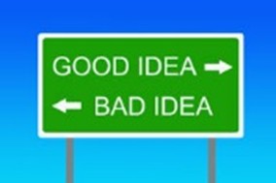
Engagement Analytics: Areas requiring more investigation / thought
We need to understand more about the % used data - what does it tell us and do we know what “good” looks like?
How should we interpret low % used data - we don’t expect users to start reading all eBooks at page 1;what would be the markers of good targeted usage of resources vs. random dipping in and out?
Data overload - Are more information and data always a good thing or do we run the risk of information overload preventing the decision making processes that we are trying to improve?
What about user engagement analytics for text-based content: Notes; Cutting and pasting; Highlights; pages turned / viewed. Can book and journal platforms support this and would it be useful?
Notes:
Would like to challenge / encourage text base publishers to consider what additional engagement analytics they could report / produce

Slide 17
Any Questions / comments? helen.adey@ntu.ac.uk

